Slide 1
UB - 3 - Regression & Forecasting Models
Flavio Bartmann
Spring 2022

Slide 2
Course Plan
1: Probability and Statistical Inference Review
2: The Simple Linear Regression Model
Formulation & Parameter Estimation – The Least Squares Method
3: Simple Linear Regression II
Inference for the Slope and Intercept – Analysis of Variance
4: Simple Linear Regression III
Model Evaluation– Residuals– Prediction
5: Multiple Linear Regression I
Model Formulation and Parameter Estimation
6: Multiple Linear Regression II
Hypothesis Testing – The F-test - Prediction
7: Multiple Linear Regression III
Analysis of Residuals
8: Transformations &Interactions
9: Categorical Predictors
10: Outliers, High-Leverage and Influential Points
11: Potential Issues with the Model – Collinearity
12: Model Selection
13: Logistic Regression
14: Course Takeaways and Further Study

Slide 3
Plan
Review of Probability and Statistics
Classical Models: The Binomial, Poisson, Exponential Distribution, and Uniform Distributions
The Basic Rules of Probability
Random Variables
Independence & Conditional Probability
Sampling Distributions and the Central Limit Theorem
Statistical Inference
Tests of significance
Confidence Intervals

Slide 4
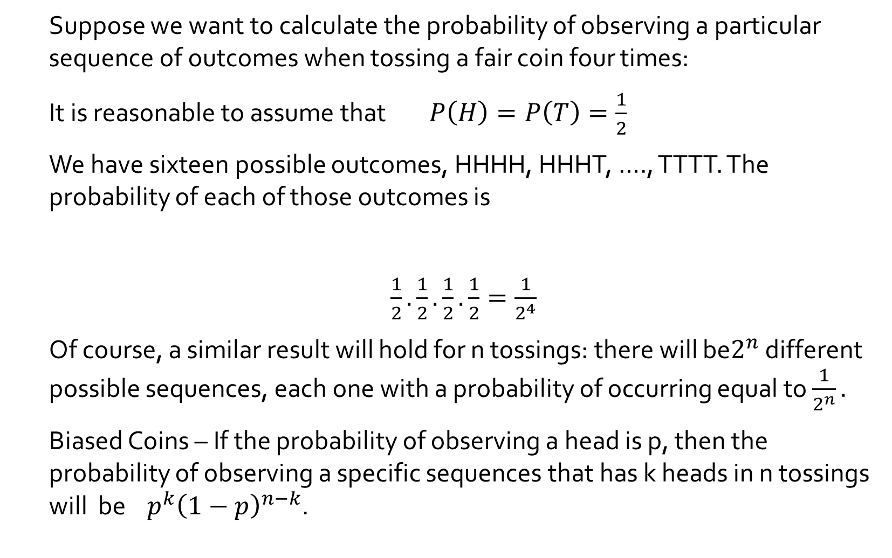
The Binomial Probability Model
Suppose we want to calculate the probability of observing a particular sequence of outcomes when tossing a fair coin four times:
It is reasonable to assume that $P\left(H\right)=P\left(T\right)=\frac{1}{2}$
We have sixteen possible outcomes, HHHH, HHHT, …., TTTT. The probability of each of those outcomes is
$\frac{1}{2}.\frac{1}{2}.\frac{1}{2}.\frac{1}{2}=\frac{1}{2^{4}}$
Of course, a similar result will hold for n tossings: there will be$2^{n}$ different possible sequences, each one with a probability of occurring equal to $\frac{1}{2^{n}}.$
Biased Coins – If the probability of observing a head is p, then the probability of observing a specific sequences that has k heads in n tossings will be $p^{k}{\left(1−p\right)}^{n−k}$.

Slide 5
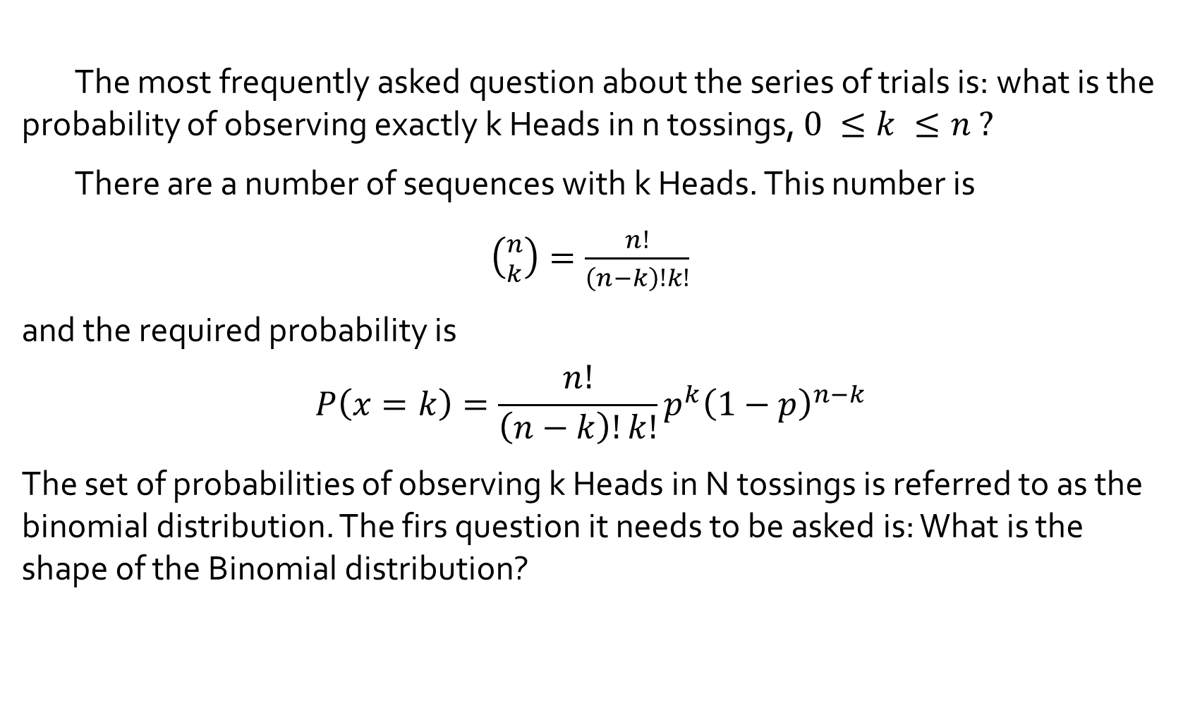
The Binomial Probability Model (continued)
The most frequently asked question about the series of trials is: what is the probability of observing exactly k Heads in n tossings, $0 ≤k ≤n ?$
There are a number of sequences with k Heads. This number is
$\left({n \atop k}\right)=\frac{n!}{\left(n−k\right)!k!}$
and the required probability is
$$P\left(x=k\right)=\frac{n!}{\left(n−k\right)!k!}p^{k}{\left(1−p\right)}^{n−k}$$
The set of probabilities of observing k Heads in N tossings is referred to as the binomial distribution. The firs question it needs to be asked is: What is the shape of the Binomial distribution?

Slide 6
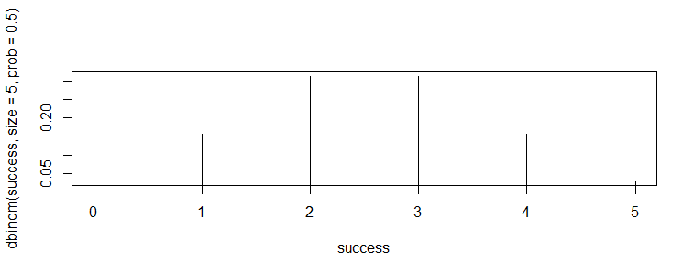
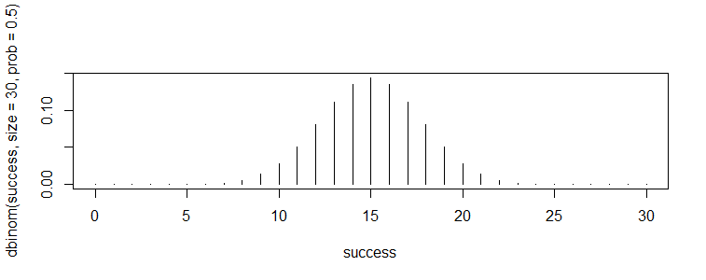
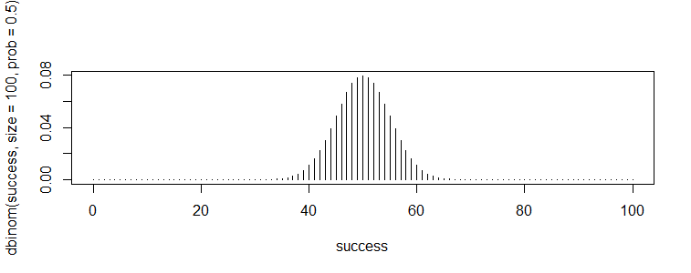
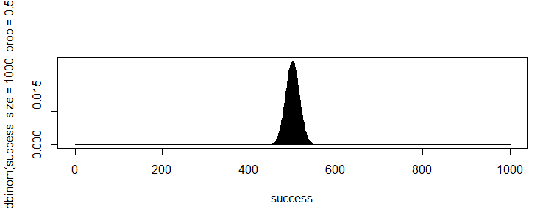
The Binomial Distribution
B(5, 0.5) (30, 0.5)
B(100,0.5) B(1000,0.5)

Slide 7
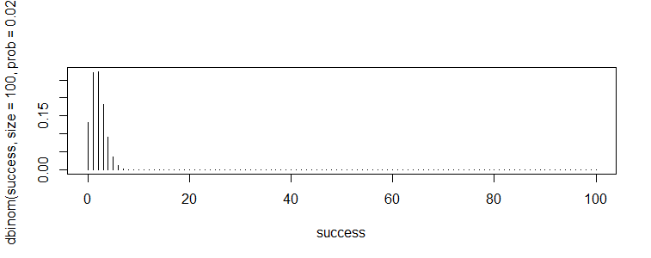
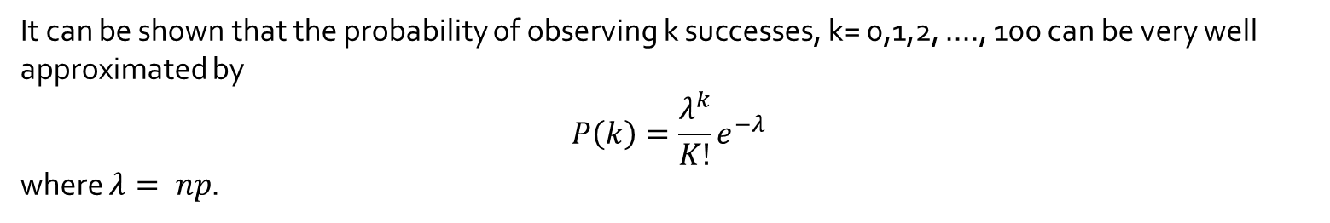
The Poisson Distribution
What happens if the number of trials is large, but the probability of success (observing the outcome of interest) is very low?
Assume, for example, that n is 100 and p=0.02. What does the distribution of the number of successes observed?
It can be shown that the probability of observing k successes, k= 0,1,2, ...., 100 can be very well approximated by
$$P\left(k\right)=\frac{λ^{k}}{K!}e^{−λ}$$
where $λ= np$.

Slide 8
The Rutherford, Chadwick and Ellis Experiment
In 1920 Rutherford, Chadwick and Ellis observed the number of particles emitted by a mass of radioactive material over 2608 time intervals of 7.5 seconds each.
The assumptions (from Physics models) were that each atom would emit a particle (disintegrate) randomly over time with the probability of the disintegration over a short period being time invariant and very small.
Under these assumptions, the number of emissions in each interval would have a Poisson distribution.

Slide 9
The Experiment Results
The table below shows the results as published.
K is the number of disintegrations in each time interval. R(k) is the number of time intervals in which exactly k disintegrations were observed. P(k) is the probability of observing exactly k disintegrations in each interval.
k | R(k) | P(K)
0 | 0.024 | 0.021
1 | 0.078 | 0.081
2 | 0.147 | 0.156
3 | 0.201 | 0.201
4 | 0.202 | 0.195
5 | 0.157 | 0.151
6 | 0.105 | 0.097
7 | 0.053 | 0.054
8 | 0.017 | 0.026
9 | 0.010 | 0.011
10 or more | 0.006 | 0.007

Slide 10
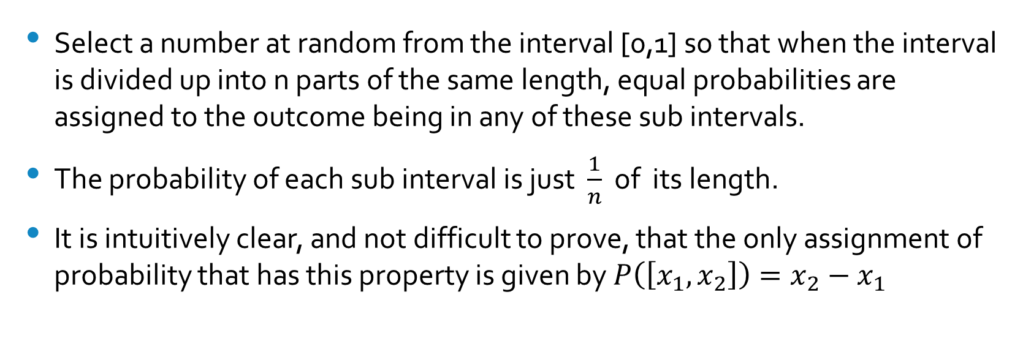
The Uniform Distribution
Select a number at random from the interval [0,1] so that when the interval is divided up into n parts of the same length, equal probabilities are assigned to the outcome being in any of these sub intervals.
The probability of each sub interval is just $\frac{1}{n}$ of its length.
It is intuitively clear, and not difficult to prove, that the only assignment of probability that has this property is given by $P\left(\left[x_{1},x_{2}\right]\right)=x_{2}−x_{1}$

Slide 11
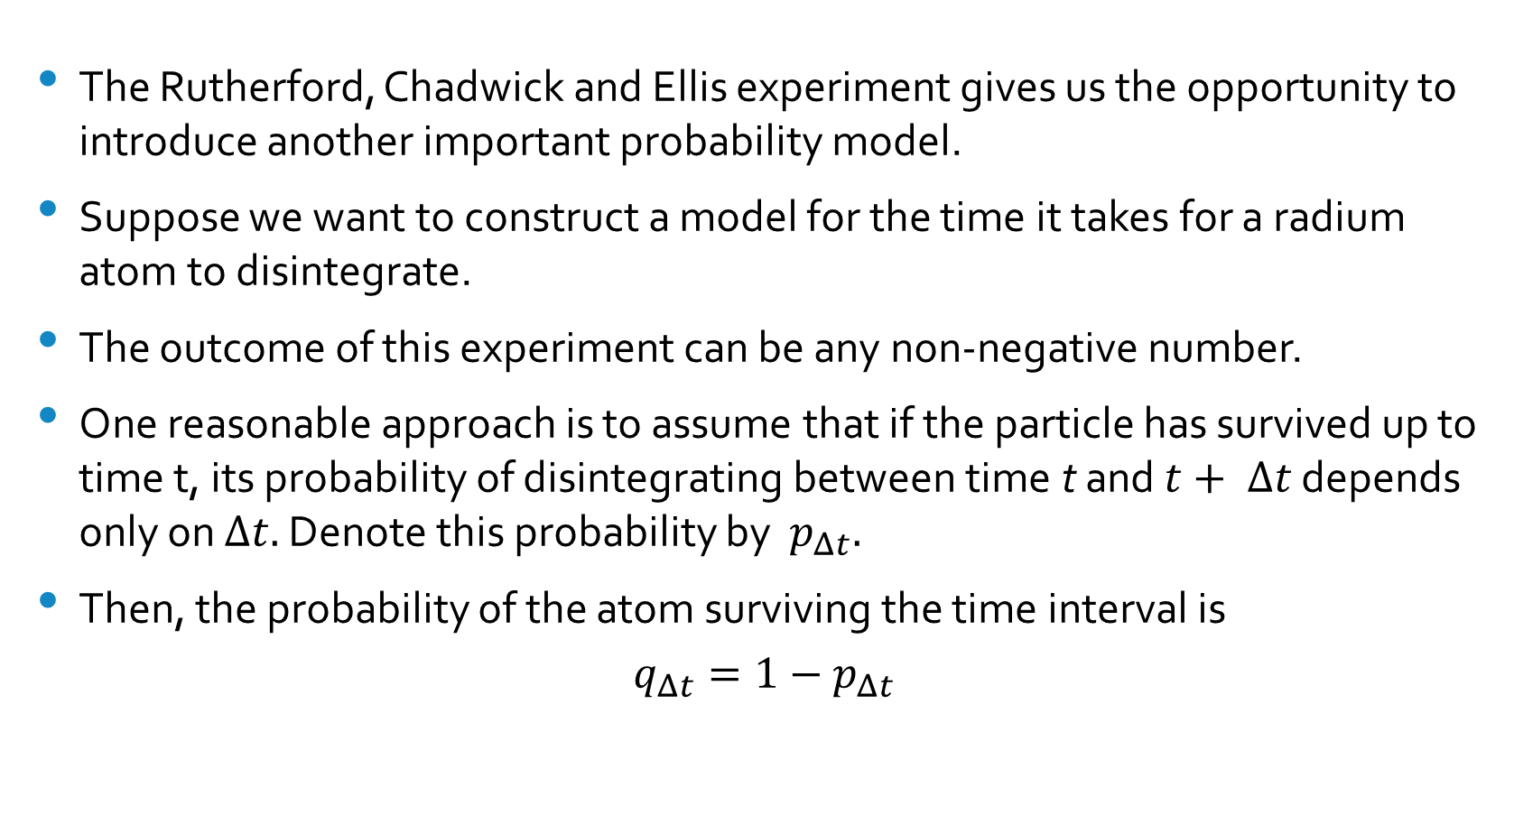
The Exponential Distribution
The Rutherford, Chadwick and Ellis experiment gives us the opportunity to introduce another important probability model.
Suppose we want to construct a model for the time it takes for a radium atom to disintegrate.
The outcome of this experiment can be any non-negative number.
One reasonable approach is to assume that if the particle has survived up to time t, its probability of disintegrating between time t and $t+ Δt$ depends only on $Δt.$ Denote this probability by $p_{Δt}.$
Then, the probability of the atom surviving the time interval is
$$q_{Δt}=1−p_{Δt}$$

Slide 12
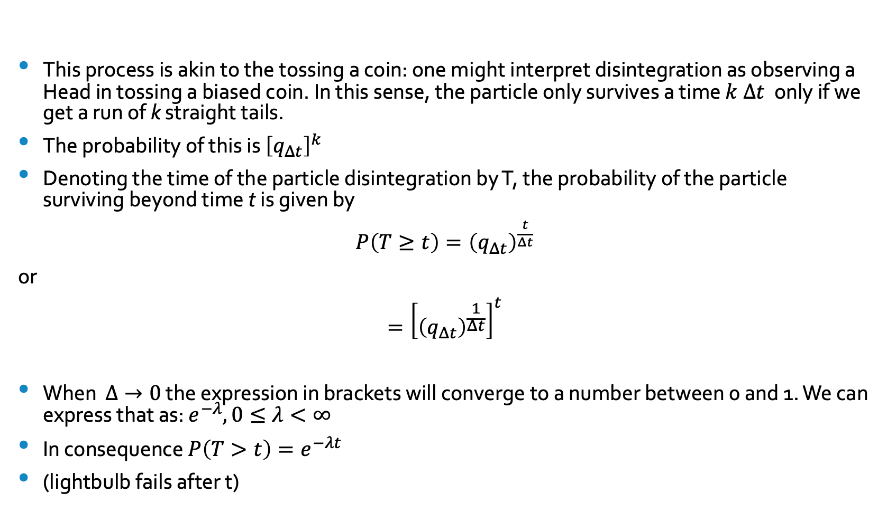
The Exponential Distribution (2)
This process is akin to the tossing a coin: one might interpret disintegration as observing a Head in tossing a biased coin. In this sense, the particle only survives a time $k Δt$ only if we get a run of k straight tails.
The probability of this is ${\left[q_{Δt}\right]}^{k}$
Denoting the time of the particle disintegration by T, the probability of the particle surviving beyond time t is given by
$P\left(T≥t\right)={\left(q_{Δt}\right)}^{\frac{t}{Δt}}$
or
$$={\left[{\left(q_{Δt}\right)}^{\frac{1}{Δt}}\right]}^{t}$$
When $Δ→0$ the expression in brackets will converge to a number between 0 and 1. We can express that as: $e^{−λ},0≤λ<∞$
In consequence $P\left(T>t\right)=e^{−λt}$
(lightbulb fails after t)

Slide 13
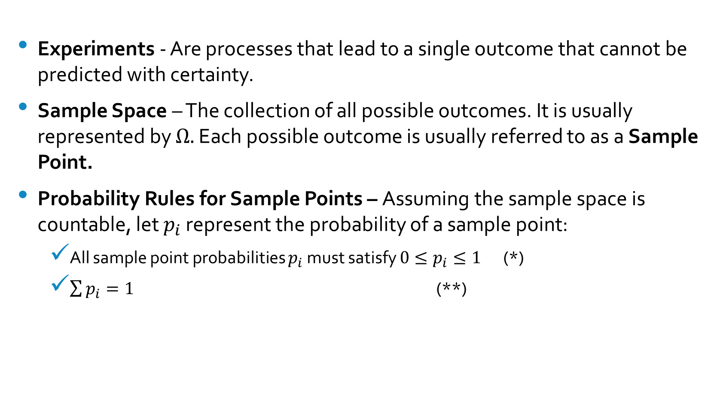
The Basic Rules of Probability
Experiments - Are processes that lead to a single outcome that cannot be predicted with certainty.
Sample Space – The collection of all possible outcomes. It is usually represented by $Ω.$ Each possible outcome is usually referred to as a Sample Point.
Probability Rules for Sample Points – Assuming the sample space is countable, let $p_{i}$ represent the probability of a sample point:
All sample point probabilities $p_{i}$ must satisfy $0≤p_{i}≤1$ (*)
$\sum{p_{i}}=1$ (**)

Slide 14
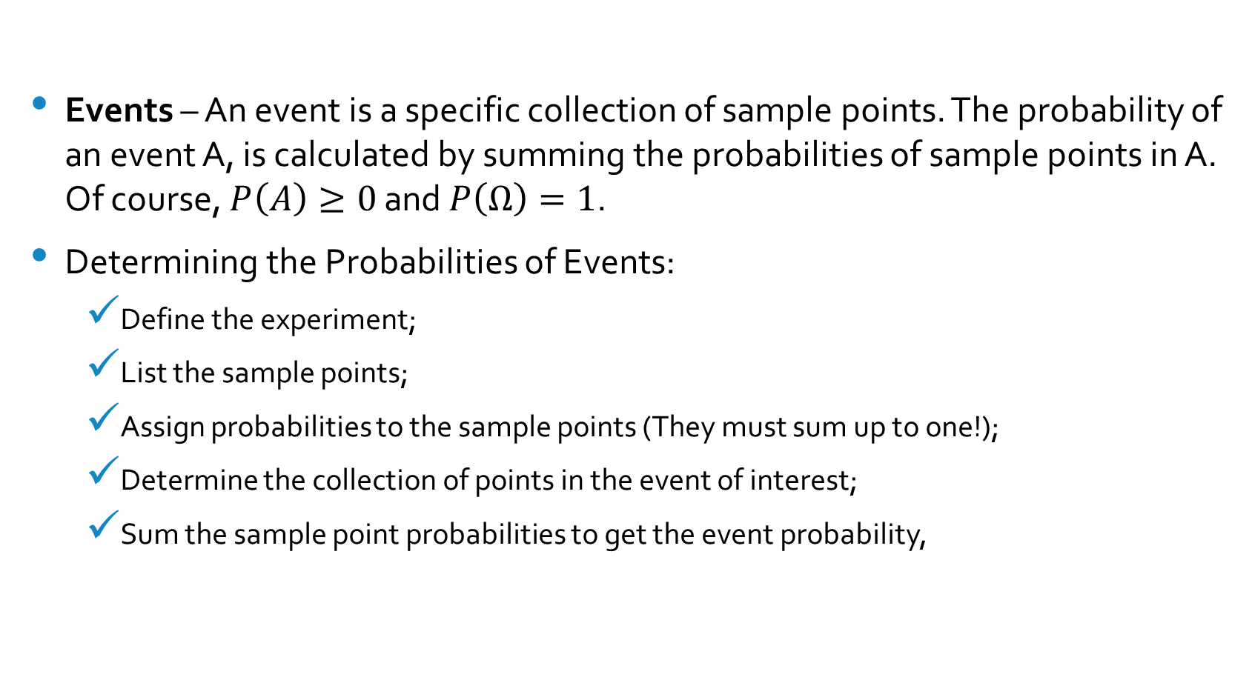
The Basic Rules of Probability (2)
Events – An event is a specific collection of sample points. The probability of an event A, is calculated by summing the probabilities of sample points in A. Of course, $P\left(A\right)≥0$ and $P\left(Ω\right)=1$.
Determining the Probabilities of Events:
Define the experiment;
List the sample points;
Assign probabilities to the sample points (They must sum up to one!);
Determine the collection of points in the event of interest;
Sum the sample point probabilities to get the event probability,

Slide 15
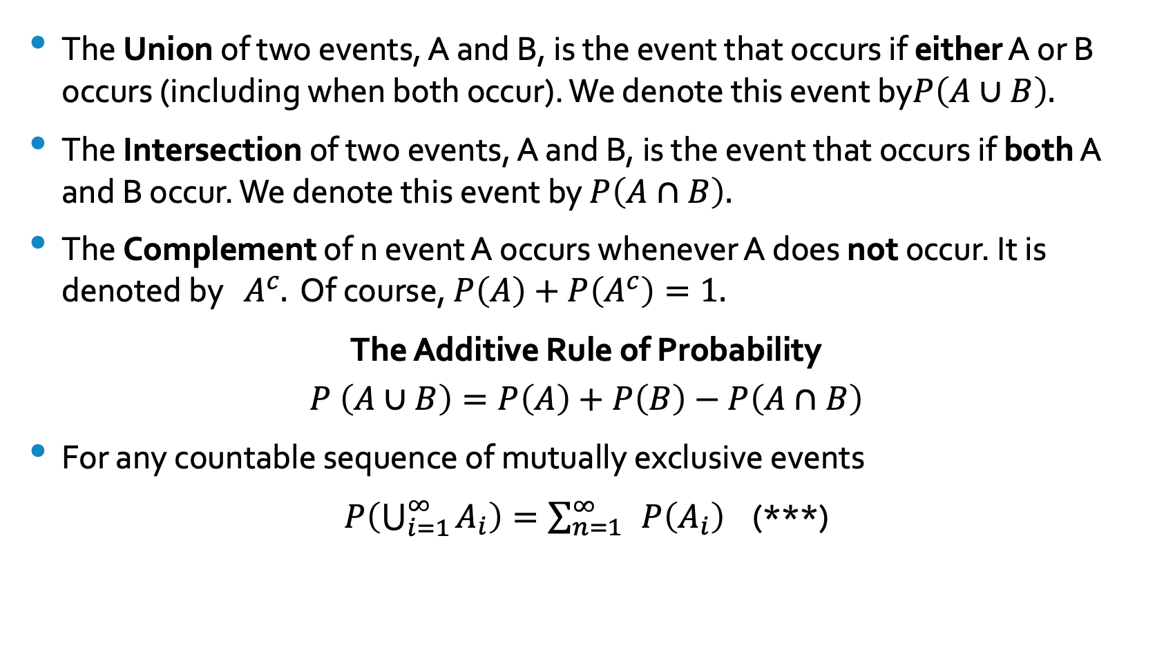
Unions, Intersections and Complements
The Union of two events, A and B, is the event that occurs if either A or B occurs (including when both occur). We denote this event by$P\left(A∪B\right).$
The Intersection of two events, A and B, is the event that occurs if both A and B occur. We denote this event by $P\left(A∩B\right).$
The Complement of n event A occurs whenever A does not occur. It is denoted by $A^{c}.$ Of course, $P\left(A\right)+P\left(A^{c}\right)=1.$
The Additive Rule of Probability
$$P \left(A∪B\right)=P\left(A\right)+P\left(B\right)−P\left(A∩B\right)$$
For any countable sequence of mutually exclusive events
$P\left(\bigcup_{i=1}^{∞}{A_{i}}\right)=\sum_{n=1}^{∞}{ }P\left(A_{i}\right)$ (***)

Slide 16
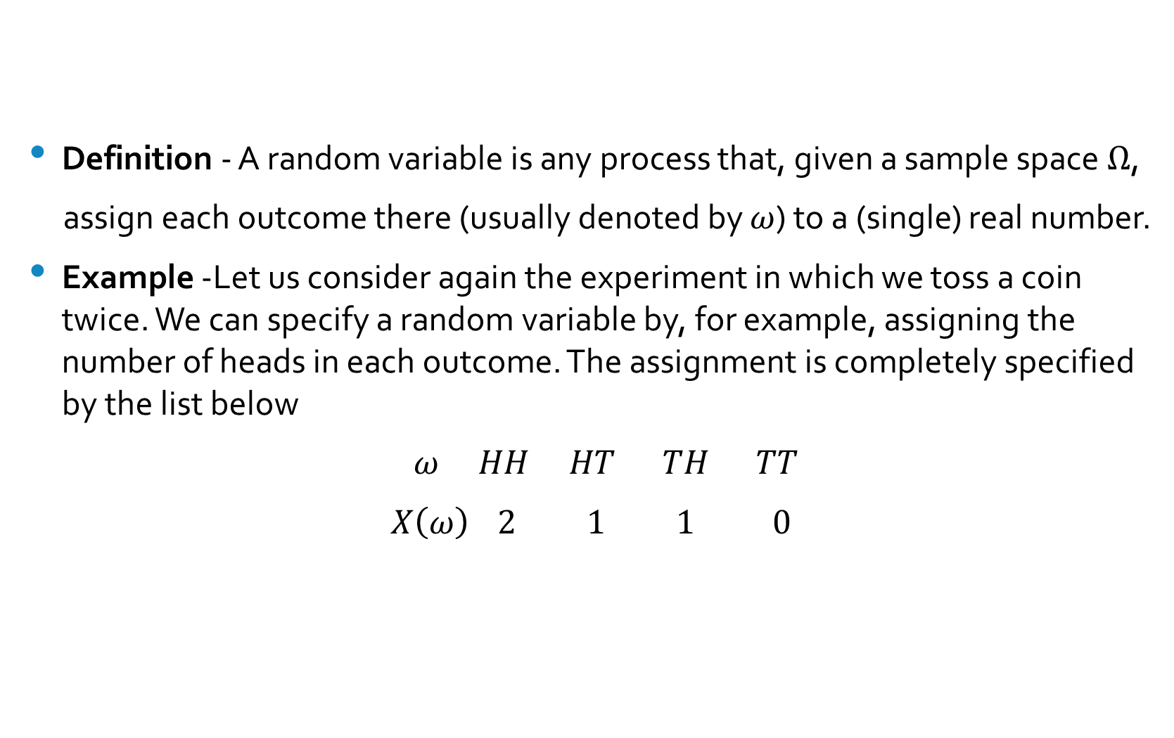
Random Variables
Definition - A random variable is any process that, given a sample space $Ω$,
assign each outcome there (usually denoted by $ω$) to a (single) real number.
Example -Let us consider again the experiment in which we toss a coin twice. We can specify a random variable by, for example, assigning the number of heads in each outcome. The assignment is completely specified by the list below
$ω HH HT TH TT$
$X\left(ω\right)$ $2$ $1$ $1$ $0$

Slide 17
Discrete Random Variables
Random variables which take values in a countable set of points, $x_{1},x_{2},…$with the probabilities specified by the numbers $P\left(X\left(ω\right)=x_{i}\right)$ are referred to as discrete random variables.
Then, obviously, the probability of any event A is just the sum of the probabilities of the points $x_{1},x_{2},…$ that are in A. That is
$$P\left(X\left(ω\right)∈A\right)=\sum_{x_{j}∈A}{P\left(X\left(ω\right)=x_{j}\right)}$$

Slide 18
Expected Values, Variance and Standard Deviation
The expected value or mean of a discrete random value is the probability weighted average of the possible values
$$μ=E\left[X\right]=\sum{x_{i}P\left(x_{i}\right)}$$
The variance of a discrete random variable X is
$$σ^{2}=E\left[{\left(X−μ\right)}^{2}\right]=\sum{{\left(x_{i}−μ\right)}^{2}P\left(x_{i}\right)}$$
The standard deviation of a discrete random variable X is equal to the positive square root of the variance, i.e.,
$$σ=\sqrt{σ^{2}}=\sqrt{\sum{{\left(x_{i}−μ\right)}^{2}P\left(x_{i}\right)}}$$

Slide 19
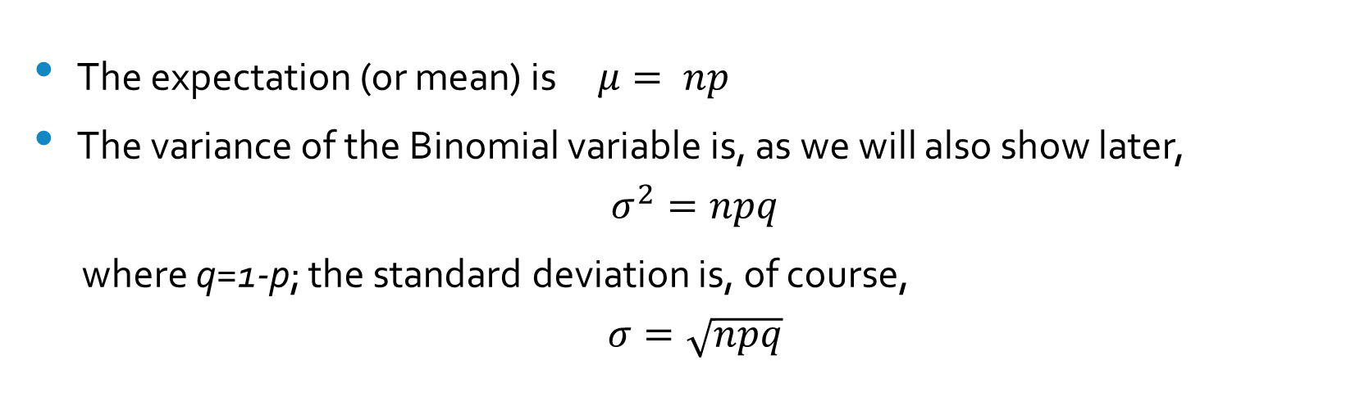
The Expectation, Variance and Standard Deviation of a Binomial Distribution
The expectation (or mean) is $μ= np$
The variance of the Binomial variable is, as we will also show later,
$$σ^{2}=npq$$
where q=1-p; the standard deviation is, of course,
$$σ=\sqrt{npq}$$

Slide 20
The Poisson Random Variable
The Poisson probability model, obtained as the limit of the Binomial model when $n→∞$ and $p→0$ in a way that $np=λ$ assigns probabilities
$P\left(X=k\right)=\frac{λ^{k}}{k!}e^{−λ}$ $k=0,1,…$
In consequence, $E\left[X\right]=λ$ and
$σ^{2}\left[X\right]=λ$
Recall that e in the formula is Euler's number, 2.71828.

Slide 21
Continuous Random Variables
Random variables which take values in the Real line (or in a set of intervals of positive length in it) and have probabilities assigned by a positive definite function f(x) such that for any interval (a,b), the probability
$$P\left(a<X<b\right)=\int_{a}^{b}{f\left(x\right)dx}$$
Please note that $\int_{−∞}^{∞}{f\left(x\right)dx}=1$.
The function f(x) is referred to as the probability density function.

Slide 22
The Uniform Random Variable
The Uniform probability model assigns probabilities to any segment $\left(x_{1}, x_{2}\right)$ within the interval (a,b) as
$$P\left(X∈\left(x_{1},x_{2}\right)\right)=\frac{x_{2}−x_{1}}{b−a}$$
This means the density function is $\frac{1}{b−a}$ for every point in (a,b) and zero elsewhere. The formula for the expected value of a continuous random variable is like that for discrete random variables but with sum substituted by an integral.
Formally, the expected value is given by
$E\left[X\right]=\int{x}f\left(x\right)dx$ = $\int_{a}^{b}{\frac{1}{b−a}}xdx=\frac{a+b}{2}$
It is a useful calculus exercise to calculate the variance which is equal to
$$σ^{2}\left[X\right]=\frac{{\left(b−a\right)}^{2}}{12}$$

Slide 23
The Exponential Random Variable
The Exponential assigns probabilities to points on positive side of the Real line according to the probability density function
$f\left(x\right)=λe^{−λx},$ $x>0.$
Please note that some books use a different notation where $\frac{1}{θ}=λ$.
The expected value is given by $E\left[X\right]=\int_{0}^{∞}{λ}xe^{−λx}=\frac{1}{λ}$
A straightforward integration yields $σ^{2}\left(X\right)=\frac{1}{λ^{2}}$
Discrete random variables usually refer to counts, number of heads in a series of coin tossings, daily number of customers coming to a store, etc. Continuous random variables usually refer to measurements, blood pressure, weight, time to an event, etc.

Slide 24
The Cumulative Distribution Function
For a given random variable $X\left(ω\right),$ the probability $P\left(X\left(ω\right)<x\right)$ depends only on x . It varies as x varies and, in consequence, it is just a function of x. It is frequently of interest and important enough to merit a name.
Definition - $F\left(x\right)=P\left(X\left(ω\right)≤x\right)$ is referred as to as the cumulative distribution function (cdf) of the random variable $X\left(ω\right).$

Slide 25
Properties of the Cumulative Distribution Function
a. 0 $≤F\left(x\right)≤1$ for all x;
B. If $x<y$ then $F\left(x\right)≤F\left(y\right)$. $F\left(x\right)$ never decreases;
If $P\left(X\left(ω\right)=x_{1}\right)=α$ then F(x) has a jump of size $α$ at the point $x_{1}.$
It should be noted that for continuous random variables we have
$$f\left(x\right)=\frac{d}{dx}F\left(x\right)$$

Slide 26
Independent Random Variables
The random variables $X_{1}\left(ω\right),…,X_{n}\left(ω\right)$ are said to be independent if
$$P\left(X_{1}\left(ω\right)∈A_{1},…,X_{n}\left(ω\right)∈A_{n}\right)=P\left(X_{1}\left(ω\right)∈A_{1}\right)∗…∗P(X_n(ω)∈A_n))$$
for all events $A_{1},…,A_{n} .$
This property implies that the distributions of observations of $X_{i}$ will have no impact whatsoever on the observations of $X_{j}$.
Note that independence is a family property

Slide 27
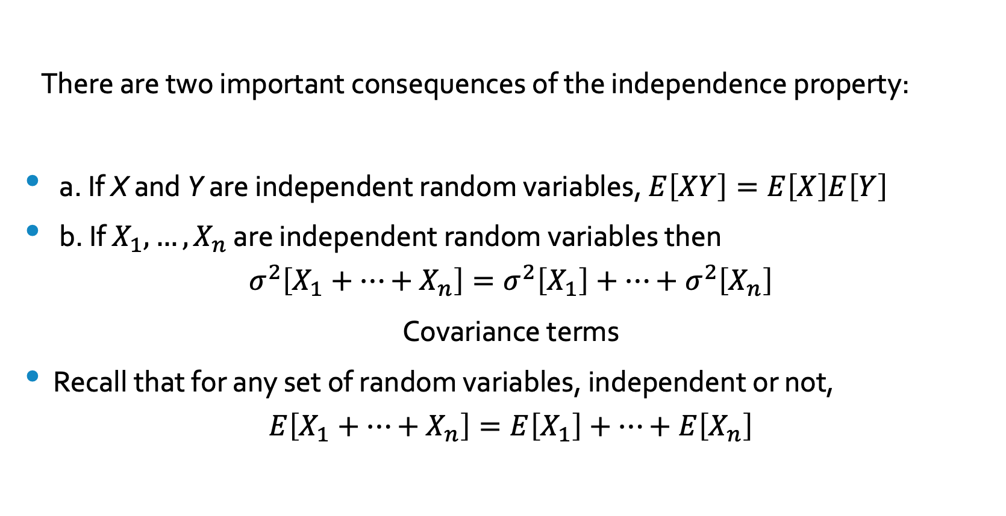
Independence, Expectations and Variances
There are two important consequences of the independence property:
a. If X and Y are independent random variables, $E\left[XY\right]=E\left[X\right]E\left[Y\right]$
b. If $X_{1},…,X_{n}$ are independent random variables then
$$σ^{2}\left[X_{1}+…+X_{n}\right]=σ^{2}\left[X_{1}\right]+…+σ^{2}\left[X_{n}\right]$$
Covariance terms
Recall that for any set of random variables, independent or not,
$$E\left[X_{1}+…+X_{n}\right]=E\left[X_{1}\right]+…+E\left[X_{n}\right]$$

Slide 28
Populations and Samples
In most situations we will not have a complete knowledge of the population of interest; in fact, we will use the observations in a sample, the sampling data, to infer the relevant characteristics of the population.
Parameters and Sample Statistics
A parameter is a numerical descriptive measure of (a model for) a population. A sample statistic is numerical descriptive measure of a sample. We will use sample statistics to estimate parameters.

Slide 29
The Distribution of the Sample Mean
Let $x_{1},…,x_{n}$ be a random sample from a given population, i.e, $X_{1},…,X_{n}$ are independent, identically distributed random variables, each with $E\left[X_{i}\right]=μ,$ and variance $σ^{2},$ i = 1,...,n.
What can we say about the distribution of the sample average, $\overline{x}$ ?
The expected value of $\overline{x}$ is obviously equal to $μ$.
The variance of the sample average is $σ_{\overline{x}}^{2}=\frac{σ^{2}}{n}$
The sample average has the same expected value as the individual observations but with a variance that is a fraction of the variances of the individual observations. But what is the shape of the distribution? The response to this question is given by the Central Limit Theorem.

Slide 30
The Normal Distribution
The Central Limit Theorem (clt) is the most important (most famous and, by far, most useful) result in the Theory of Probability. It states that, under very general conditions, the sum of independent variables will be approximately normally distributed.
Before we state the theorem, let us introduce the normal distribution. A random variable with pdf
$f\left(x\right)=\frac{1}{\sqrt{2π}σ}e^{−\frac{1}{2}{\left(\frac{x−μ}{σ}\right)}^{2}}$ $−∞≤x ≤∞$
where $μ$ and $σ>0$ are real numbers, is referred as Normally distributed random variable.

Slide 31
Important Facts about the Normal Distribution
a. $f\left(x\right)$ is defined for all $x∈R$.
b. The values of the pdf are a function of two parameters $μ$ and $σ,$ the mean (expected value) and standard deviation of the variable respectively;
c. The maximum of the density function occurs at $x = μ;$ and
d. $f\left(x\right)$ declines rapidly as x moves away from $μ$. It is close to zero when$\left|x−μ\right|>3σ$.

Slide 32
The Standard Normal Distribution
The normal distribution when $μ= 0$ and $σ= 1$ is referred as the standard normal distribution. Probabilities in any normal distribution are calculated by converting it to a standard normal first, and then, by reference to a table of Normal Curve probabilities.
The conversion to a Standard Normal Distribution is straightforward. If X is a normal random variable with mean $μ$ and variance $σ^{2}$ then
$Z=\frac{X−μ}{σ}$
has a standard normal distribution. The value Z measures the number of standard deviations between x and $μ.$

Slide 33
The Central Limit Theorem
Let $X_{1},…,X_{n}$ be independent, identically distributed random variables with mean $μ$ and variance $σ^{2}.$ Then the distribution of $\overline{x}$ will be approximately normal with $μ_{\overline{x}}=μ$ and variance $σ_{\overline{x}}^{2}=\frac{σ^{2}}{n}$.
An alternative formulation states that $S_{n}=X_{1}+…+X_{n}$ will have a normal distribution with $μ\left[S_{n}\right]=n.μ$, and variance $σ_{S_{n}}^{2}=n.σ^{2}$
The approximation gets better, and very quickly, with n.

Slide 34
Examples
Example 1 - What is the probability of observing more than 600 Heads in 1,000 tossings of a fair coin? What is the probability of observing a number between 470 and 530?
Solution - Assume that $X_{i}=1$ if Heads comes up in the $i^{th}$ toss. The number of Heads in the experiment will be
$$S_{1000}=\sum_{i=1}^{1000}{X_{i}}$$
By the central limit theorem, $S_{1000}$ has an approximately normal distribution with $μ=500$ and $σ^{2}=250$ with $σ= 15.81$. The value of 600 in the distribution of $S_{n}$ can be converted to a z-score by subtracting the mean, 500 and scaling (dividing) by the standard deviation, 15.81 :
$$z=\frac{600−500}{15.81}=6.324$$
The probability of observing more than 600 Heads in 1000 tossings is equal to the $P\left(z≥6.324\right)$ which is effectively zero.

Slide 35
Examples - Continued
The probability of observing between 470 and 530 Heads is
$P\left(470≤S_{1000}≤530\right)=$ $P ($ $\frac{470−500}{15.81}$ $≤z ≤$ $\frac{530−500}{15.81}$ $) = 2. P$ $( 0≤z ≤1.8976) = 0.9426$
The proportion of Heads in 1000 tossings will be between 47 and 53% about 94% of the time.

Slide 36
Example 2
The town of Greenfield has a public lighting system with 1,000 streetlights. Weekly failures of streetlights follow a Poisson distribution with $λ= 4.$ Assume that Greenfield replaces the failed lights immediately. What is the probability that Greenfield will need to replace more than 250 lights next year?
Let N be the number of lights that need to be replaced next year. The central limit theorem implies N will be approximately normal with $μ= 208$ and with $σ=\sqrt{208}=14.42$. In consequence,
$$P\left(N>250\right)=P\left(N>\frac{250−208}{14.42}\right)=P\left(z>2.91\right)=0.0018$$
or 0.18%.

Slide 37
Convergence Speed
How quickly do the distributions of the sample means and of the sums of i.i.d. random variables converge to the normal? The general answer is pretty quickly. But the exact speed depends on the shape of original distribution. One of the slowest convergences occurs when the original distribution is the binomial. The plots below superimpose the normal approximation cdf on the binomial cdf for 36 and 144 trials with p=0.5. The approximation is already very good for n=36. For 144 trials the two curves are virtually indistinguishable.

Slide 38
Convergence Speed
For i.i.d. random variable samples the normal approximation is very good if n is 30 or greater in almost all cases. For continuous distributions, the convergence is even quicker: for the uniform, a sample size of six is enough for the approximation to be very, very good.

Slide 39
Convergence Speed Again
The random variable $Z=U_{1}+U_{2}$ , a sum of two uniforms U[0,1] was simulated 100,000 times. The histogram of Z is given below, on the left. Its shape is exactly what we would expect. On the right we show a the relevant Q-Q plot. The curve is stil not a straight line but is close to it.

Slide 40
Convergence Speed Continued
In a third step 100,000 sums of ten uniforms, $Z=\sum_{i=1}^{10}{U_{i}}$, were simulated. Both the histogram of the results and the relevant Q-Q plot are shown below. Both show that Z has a distribution that is indistinguishable from the normal.

Slide 41
Conditional Probability
Not all random variables are independent. In many situations the knowledge that an event has occurred impacts the probability of the occurrence of another event.
Definition - The probability of the event B given that A has occurred, denoted by $P\left(B | A\right)$ is given by
$$P\left(B | A\right)=\frac{P\left(A∩B\right)}{P\left(A\right)}$$
The expression above is referred as the Conditional Probability Formula.

Slide 42
Warning
Although the Conditional Probability Formula is extremely simple, it is frequently misunderstood. Take for example the set of diagrams below, taken from a popular website dedicated to Biostatistics, which purports to enumerate the possible base cases of conditional statistics.
The first panel, that one on the left is clearly wrong. The conditional probability is $P\left(A | B\right)=\frac{P\left(B∩A\right)}{P\left(B\right)}=\frac{P\left(A\right)}{P\left(B\right)}≠1$

Slide 43
Conditional Probability and Independence
Proposition - It can be easily shown that two random variables X and Y are independent if and only if
$$P\left(X∈A | Y∈B\right)=P\left(X∈A\right)$$
The Addition Rule for Conditional Probabilities - Assume that Y takes only the values $y_{1},…,y_{k}.$ A useful rule in calculating probabilities of events is $P\left(X∈A\right)=\sum_{k}{P\left(X∈A | Y=y_{k}\right)P\left(Y=y_{k}\right)}$

Slide 44
The Bayes Theorem
No medical test is one hundred percent accurate. Tests produce false-positives (a patient is deemed sick but is, in fact healthy) and false-negatives (a patient is deemed healthy but is, in fact sick). Interpreting test results properly require a bit of Probability Theory.
To illustrate the process, consider that a patient goes to see a doctor. The doctor performs a test with 99 percent reliability--that is, 99 percent of people who are sick test positive (this is called the sensitivity of the test) and 99 percent of the healthy people test negative (this is called the specificity of the test). The doctor knows that only 1 percent of the people in the country are sick. Now the question is: if the patient tests positive, what are the chances the patient is sick?
The intuitive answer is 99 percent, but the correct answer is very different. The solution to the question can easily be calculated using Bayes' theorem. Bayes, who was a reverend who lived in 18th Century England stated that the probability you test positive AND are sick is the product of the likelihood that you test positive GIVEN that you are sick and the "prior" probability that you are sick (the prevalence in the population). Bayes' theorem allows one to compute a conditional probability based on the available information.

Slide 45
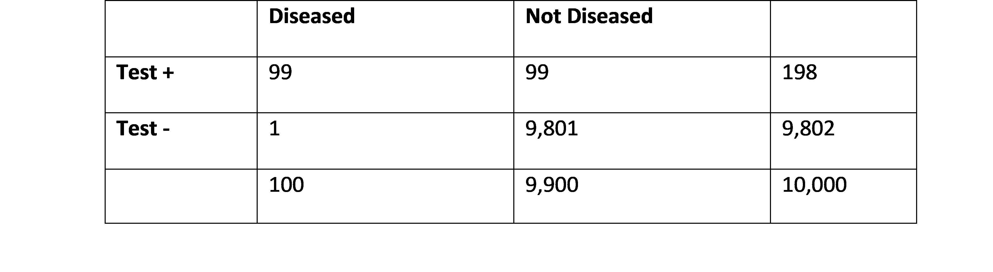
Bayes Theorem - Continued
The theorem states that
$$P\left(A | B\right)=\frac{P\left(B | A\right)P\left(A\right)}{P\left(B\right)}$$
Let’s consider a hypothetical population of 10,000 individuals. Using the values for sensitivity and specificity given we have

Slide 46
Bayes Theorem - Continued
In this scenario P(A) is the unconditional probability of disease; here it is 100/10,000 = 0.01.
P(B) is the unconditional probability of a positive test; here it is 198/10,000 = 0.0198.
What we want to know is P (A | B), i.e., the probability of disease (A), given that the patient has a positive test (B). We know that prevalence of disease (the unconditional probability of disease) is 1% or 0.01; this is represented by P(A). Therefore, in a population of 10,000 there will be (theoretically) 100 diseased people and 9,900 non-diseased people. We also know the sensitivity of the test is 99%, i.e., P(B|A) = 0.99; therefore, among the 100 diseased people, 99 should test positive. We also know that the specificity is 99% as well, or that there is a 1% error rate in non-diseased people. Therefore, among the 9,900 non-diseased people, 99 will have a positive test. And from these numbers, it follows that the unconditional probability of a positive test is 198/10,000 = 0.0198; this is P(B).
Thus, P(A| B) = (0.99 x 0.01) / 0.0198 = 0.50 = 50%.
From the table above, we can also see that given a positive test (subjects in the Test + row), the probability of disease is 99/198 = 0.5 = 50.

Slide 47
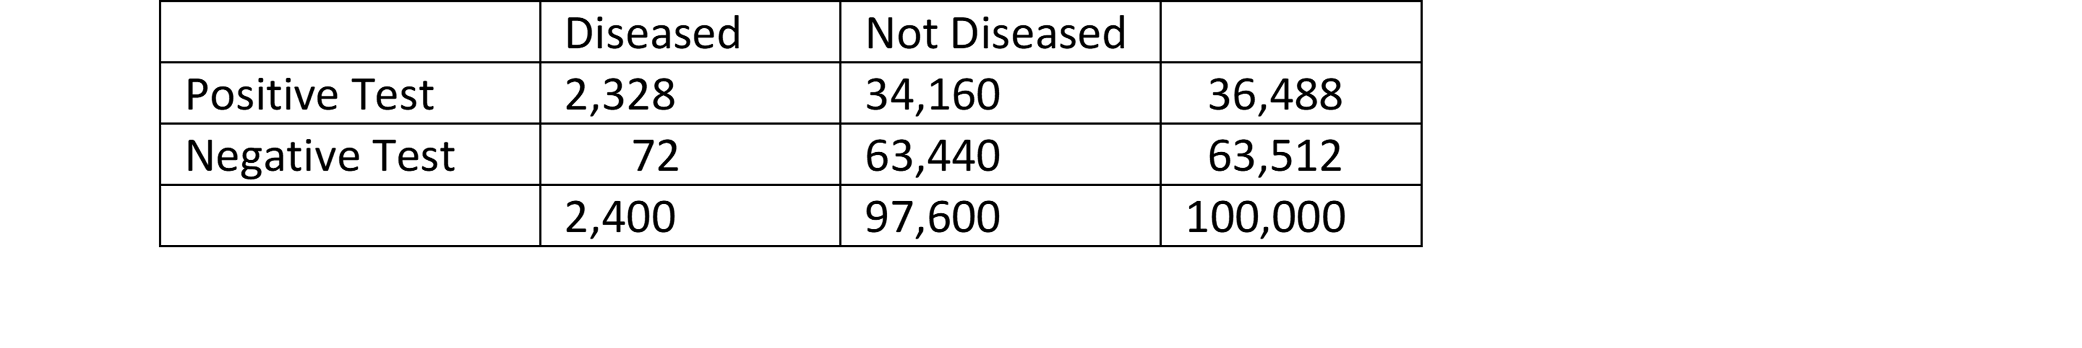
Analysis
The easiest way to calculate the required probabilities is to consider a hypothetical population, say, of 100,000 women who would be subject to mammograms. Entering the values for incidence of the disease and the performance characteristics of the test we can construct the following table:
P(D|+) and P(ND|-) are easily computed as: $P\left(D | +\right)=\frac{2,328}{36,488}=0.0638$ and $P\left(ND | −\right)=\frac{63,540}{63,612}=0.9988$.

Slide 48
Darwin Experiments
In 1874, in a series of experiments, Darwin examined the effects of cross and self fertilization in a number of plant species looking for experimental evidence for his hypothesis; he reported on experiments conducted on over 60 different species of plants, where he used controlled pollinations in order to produce self-fertilized and cross-fertilized descendants.
In one of these experiments Darwin compared the heights of 15 pairs of cross-fertilized and self-fertilized plants of the species Zea mays, corn (Maize in England. Corn is the most planted cereal in the world.) which he seeded in four large pots. The following page shows the data as originally presented in Darwin's book.

Slide 49
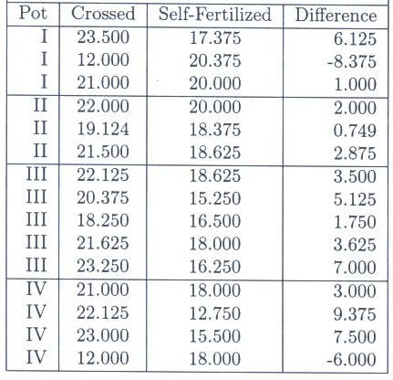
Back to Darwin's Data
The table below reproduces the original data collected by Darwin adding an additional column giving the difference in heights for each pair.

Slide 50
Darwin Questions
The question Darwin posed was: What can we say about the effect of cross-fertilization in Zea Mays plants? Can we say, on the basis of the results of the experiment, that cross-fertilized corn plants are, in general, on average, taller than the self-fertilized ones?
Questions such as this are considered in a large number of situations. For example, in medical contexts, it is of great interest to know whether drug A is more effective than drug B in the treatment of some illness. A similar situation arises when we want to determine if a method, process or test performs at the levels claimed.

Slide 51
What was Darwin trying to understand?
Darwin’s question needs to be considered carefully. The question asked is not as simple as it first appears.
First, what is meant by "...in general, on average, taller ..."?
Second, what is the group of corn plants Darwin wants make a statement about?
Third, what are the possible answers? How sure can we be of their correctness? What is the uncertainty associated with each possible answer?

Slide 52
The Formal Framework
The question Darwin asked is now answered through the performance of a statistical test (sometimes referred to as a significance test) where a truthfulness of a statement, a (statistical) hypothesis, is evaluated on the basis of observed data modeled as the realized values taken by a collection of random variables.
This framework, which is outlined below, was developed by Ronald Fisher in 1925. He defined what type of statements could be evaluated and detailed procedures to evaluate the truthfulness of those.
In reality, there are two possibilities: the statement is either true or not true. On the basis of the data observed in the experiment, we may want to decide the statement either true or not true. The situation is summarized in the diagram that follows. A key objective is to calculate the probabilities of the potential errors.

Slide 53
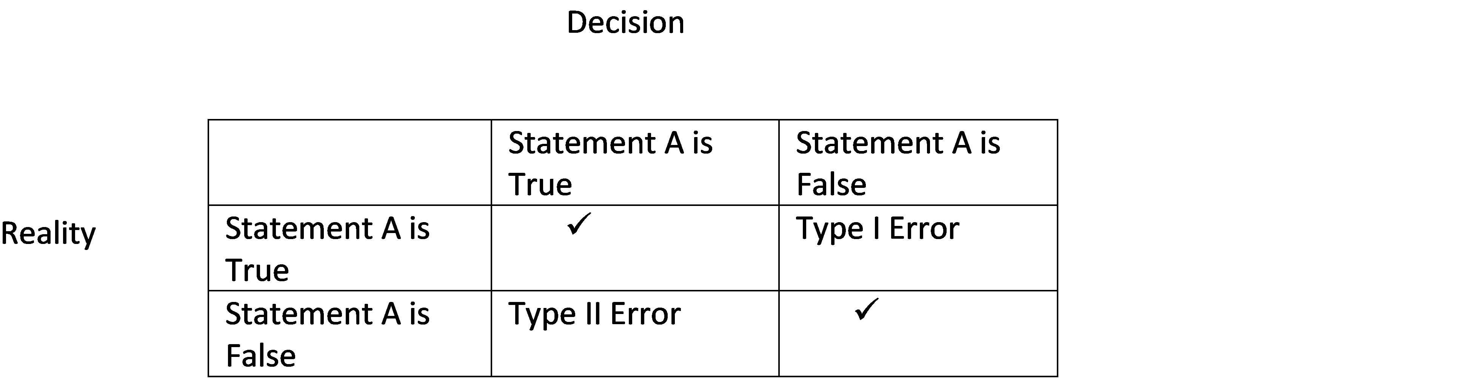
Decisions vs. Reality

Slide 54
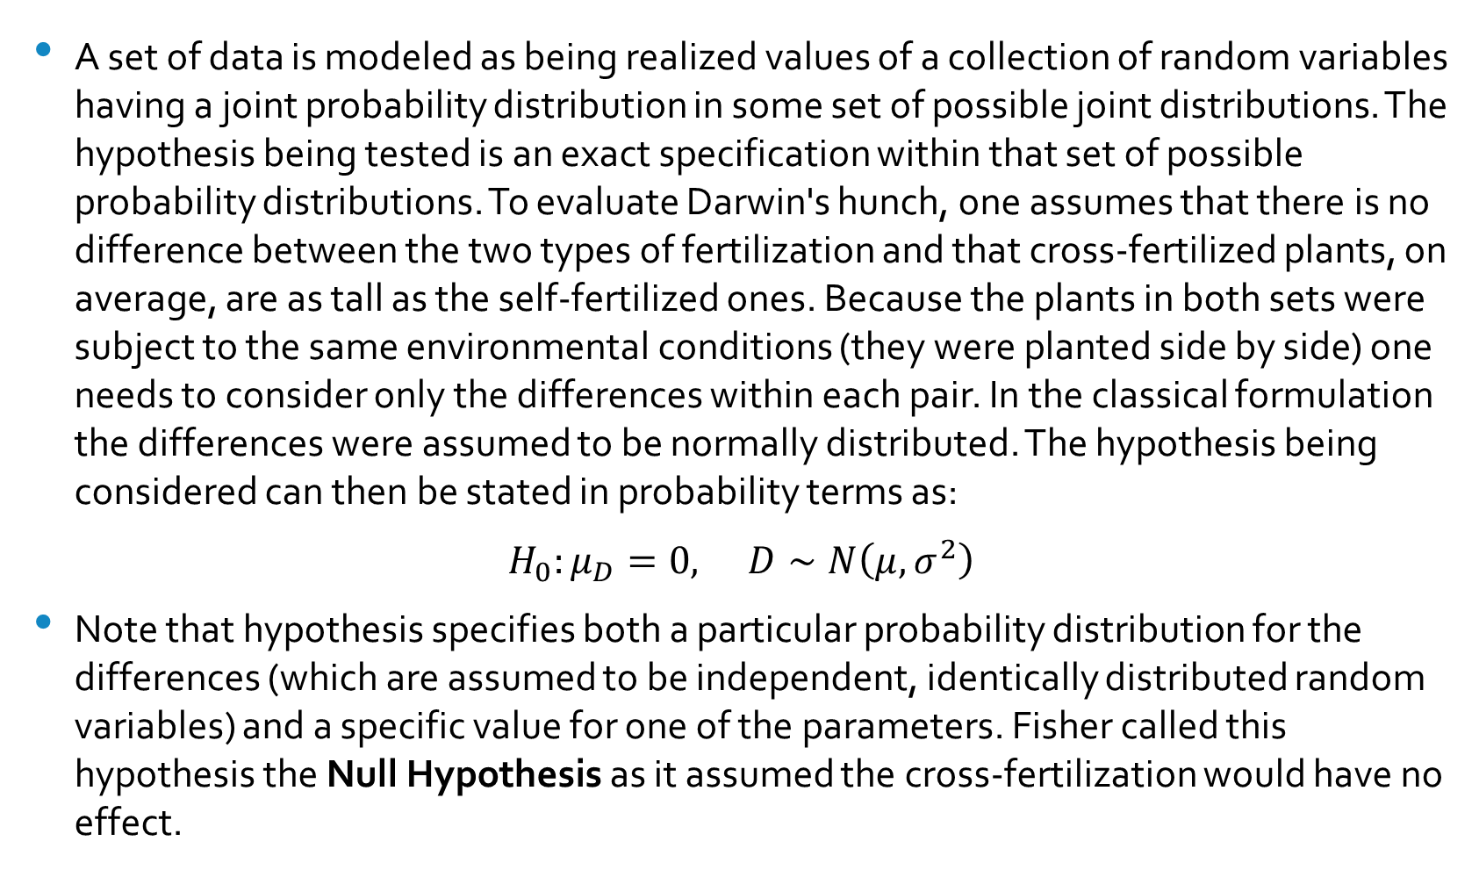
The Null Hypothesis
A set of data is modeled as being realized values of a collection of random variables having a joint probability distribution in some set of possible joint distributions. The hypothesis being tested is an exact specification within that set of possible probability distributions. To evaluate Darwin's hunch, one assumes that there is no difference between the two types of fertilization and that cross-fertilized plants, on average, are as tall as the self-fertilized ones. Because the plants in both sets were subject to the same environmental conditions (they were planted side by side) one needs to consider only the differences within each pair. In the classical formulation the differences were assumed to be normally distributed. The hypothesis being considered can then be stated in probability terms as:
$H_{0}:μ_{D}=0,$ $D∼N\left(μ,σ^{2}\right)$
Note that hypothesis specifies both a particular probability distribution for the differences (which are assumed to be independent, identically distributed random variables) and a specific value for one of the parameters. Fisher called this hypothesis the Null Hypothesis as it assumed the cross-fertilization would have no effect.

Slide 55
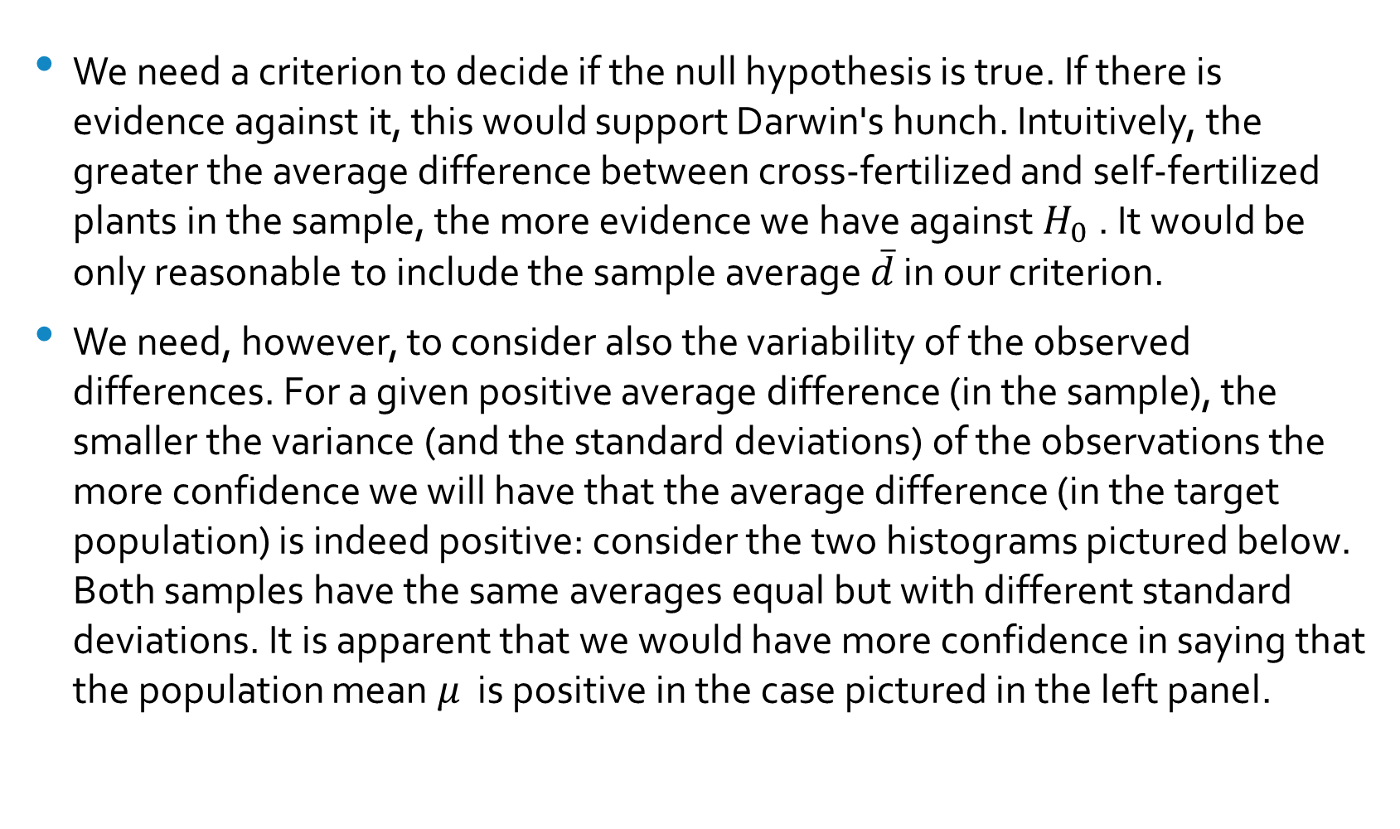
The Test Statistic
We need a criterion to decide if the null hypothesis is true. If there is evidence against it, this would support Darwin's hunch. Intuitively, the greater the average difference between cross-fertilized and self-fertilized plants in the sample, the more evidence we have against $H_{0}$ . It would be only reasonable to include the sample average $\overline{d}$ in our criterion.
We need, however, to consider also the variability of the observed differences. For a given positive average difference (in the sample), the smaller the variance (and the standard deviations) of the observations the more confidence we will have that the average difference (in the target population) is indeed positive: consider the two histograms pictured below. Both samples have the same averages equal but with different standard deviations. It is apparent that we would have more confidence in saying that the population mean $μ$ is positive in the case pictured in the left panel.

Slide 56
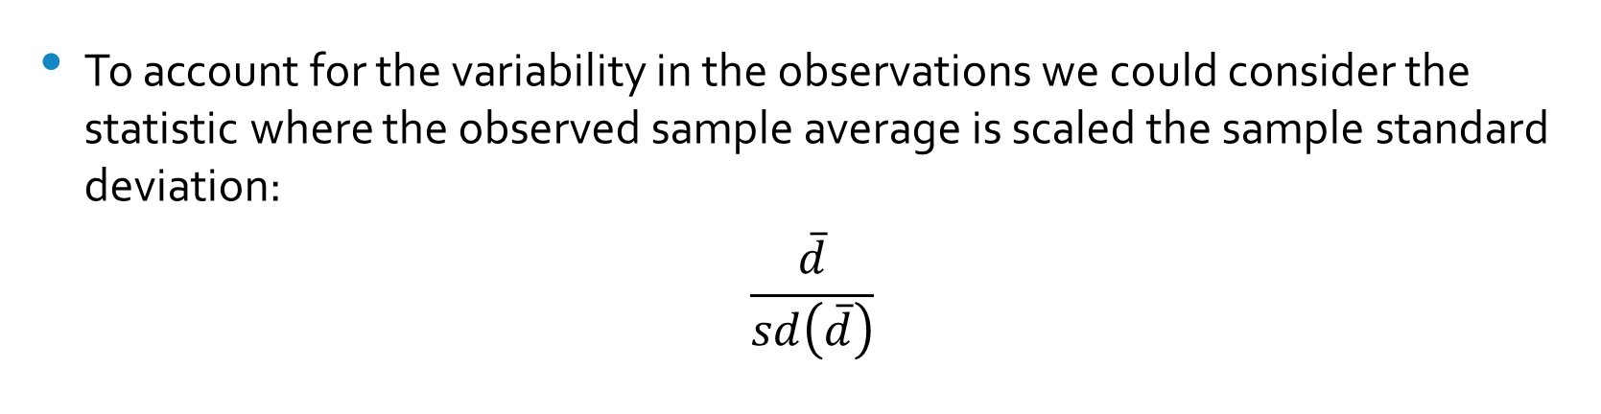
The Test Statistic (Continued)
To account for the variability in the observations we could consider the statistic where the observed sample average is scaled the sample standard deviation:
$$\frac{\overline{d}}{sd\left(\overline{d}\right)}$$

Slide 57
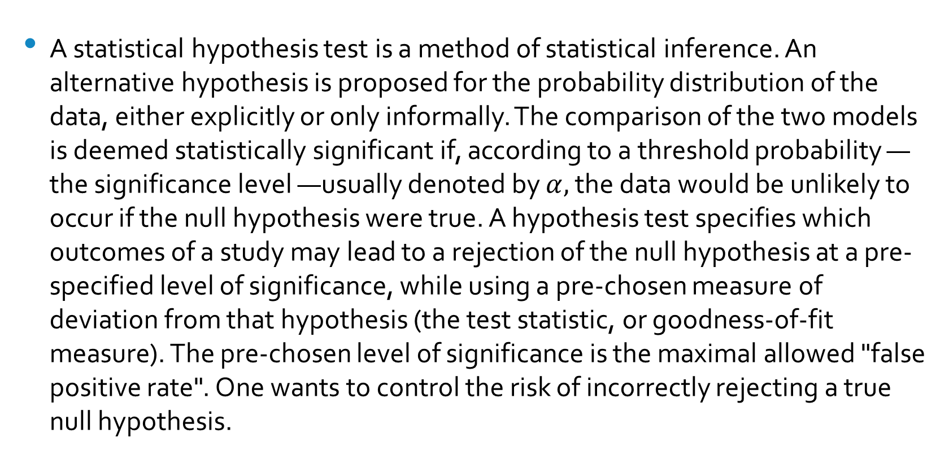
Making a Decision about $H_{0}$
A statistical hypothesis test is a method of statistical inference. An alternative hypothesis is proposed for the probability distribution of the data, either explicitly or only informally. The comparison of the two models is deemed statistically significant if, according to a threshold probability —the significance level —usually denoted by $α,$ the data would be unlikely to occur if the null hypothesis were true. A hypothesis test specifies which outcomes of a study may lead to a rejection of the null hypothesis at a pre-specified level of significance, while using a pre-chosen measure of deviation from that hypothesis (the test statistic, or goodness-of-fit measure). The pre-chosen level of significance is the maximal allowed "false positive rate". One wants to control the risk of incorrectly rejecting a true null hypothesis.

Slide 58
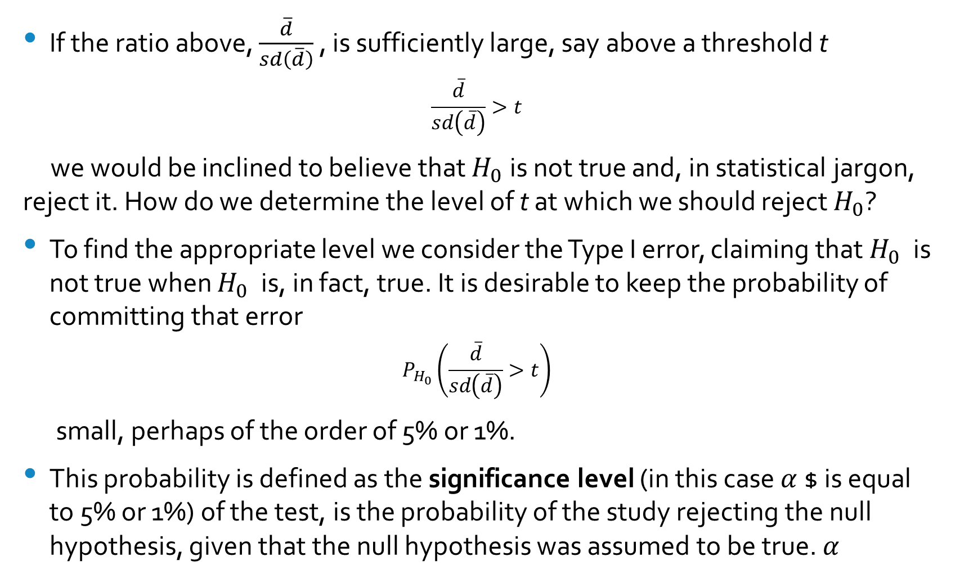
Rejecting $H_{0}$
If the ratio above, $\frac{\overline{d}}{sd\left(\overline{d}\right)}$ , is sufficiently large, say above a threshold t
$$\frac{\overline{d}}{sd\left(\overline{d}\right)}>t$$
we would be inclined to believe that $H_{0}$is not true and, in statistical jargon, reject it. How do we determine the level of t at which we should reject $H_{0}$?
To find the appropriate level we consider the Type I error, claiming that $H_{0}$ is not true when $H_{0}$ is, in fact, true. It is desirable to keep the probability of committing that error
$$P_{H_{0}}\left(\frac{\overline{d}}{sd\left(\overline{d}\right)}>t\right)$$
small, perhaps of the order of 5% or 1%.
This probability is defined as the significance level (in this case $α$$ is equal to 5% or 1%) of the test, is the probability of the study rejecting the null hypothesis, given that the null hypothesis was assumed to be true. $α$

Slide 59
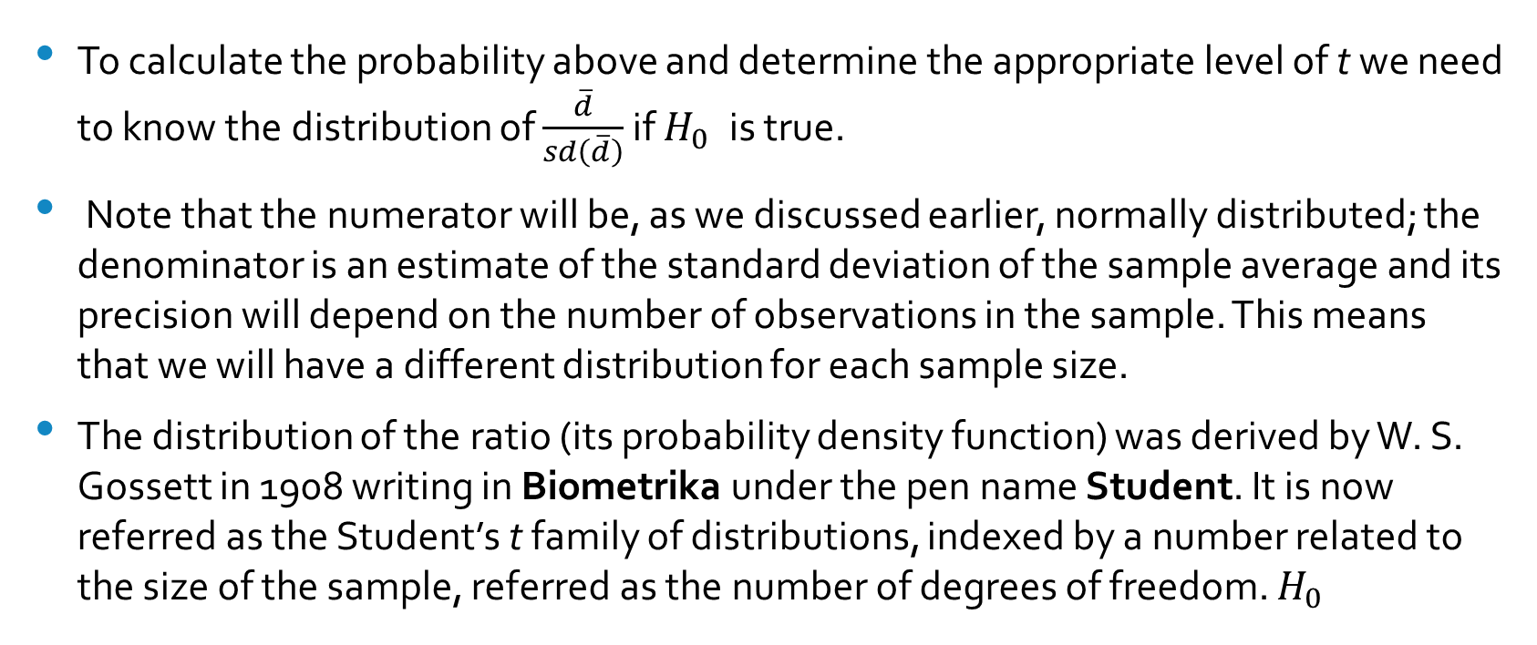
The Yardstick
To calculate the probability above and determine the appropriate level of t we need to know the distribution of $\frac{\overline{d}}{sd\left(\overline{d}\right)}$ if $H_{0}$ is true.
Note that the numerator will be, as we discussed earlier, normally distributed; the denominator is an estimate of the standard deviation of the sample average and its precision will depend on the number of observations in the sample. This means that we will have a different distribution for each sample size.
The distribution of the ratio (its probability density function) was derived by W. S. Gossett in 1908 writing in Biometrika under the pen name Student. It is now referred as the Student’s t family of distributions, indexed by a number related to the size of the sample, referred as the number of degrees of freedom. $H_{0}$

Slide 60
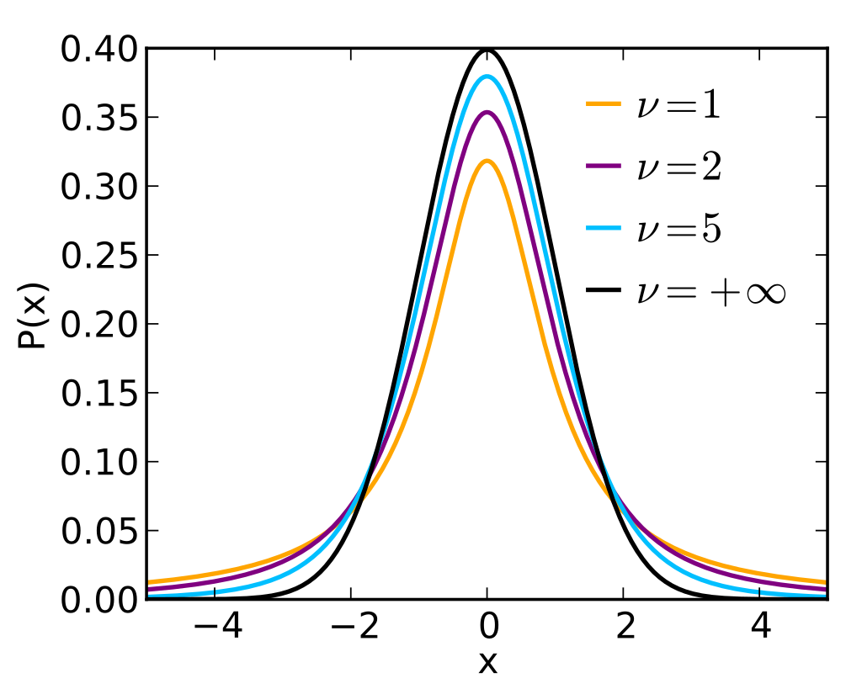
t-distributions
It is family of continuous probability distributions that arise when estimating the mean of a normally-distributed population in situations where the sample size is small, and the population's standard deviation is unknown.
Random variables with a t-distribution is defined for real numbers; it has mean zero.

Slide 61
Back to Darwin's Data
The table below reproduces the original data collected by Darwin adding an additional column giving the difference in heights for each pair.

Slide 62
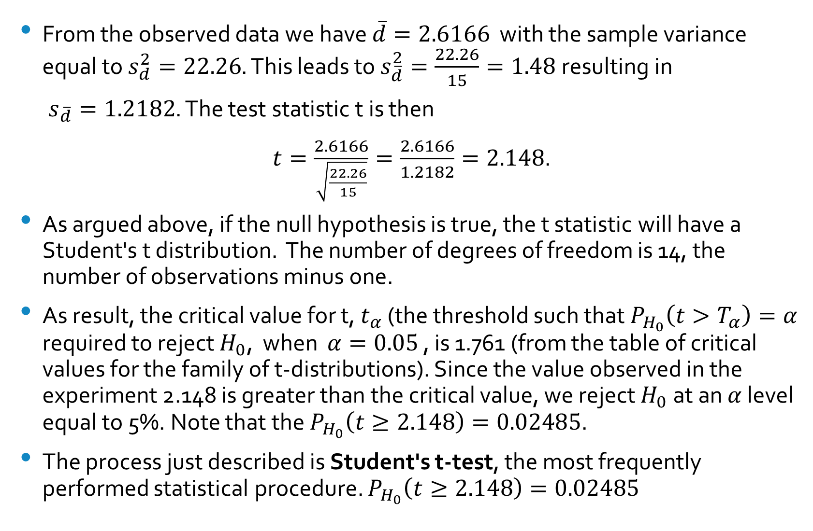
Doing the Numbers
From the observed data we have $\overline{d}=2.6166$ with the sample variance equal to $s_{d}^{2}=22.26$. This leads to $s_{\overline{d}}^{2}=\frac{22.26}{15}=1.48$resulting in
$s_{\overline{d}}=1.2182$. The test statistic t is then
$t=\frac{2.6166}{\sqrt{\frac{22.26}{15}}}=\frac{2.6166}{1.2182}=2.148$.
As argued above, if the null hypothesis is true, the t statistic will have a Student's t distribution. The number of degrees of freedom is 14, the number of observations minus one.
As result, the critical value for t, $t_{α}$ (the threshold such that $P_{H_{0}}\left(t>T_{α}\right)=α$ required to reject $H_{0}$, when $α=0.05$ , is 1.761 (from the table of critical values for the family of t-distributions). Since the value observed in the experiment 2.148 is greater than the critical value, we reject $H_{0}$at an $α$ level equal to 5%. Note that the $P_{H_{0}}\left(t≥2.148\right)=0.02485$.
The process just described is Student's t-test, the most frequently performed statistical procedure. $P_{H_{0}}\left(t≥2.148\right)=0.02485$

Slide 63
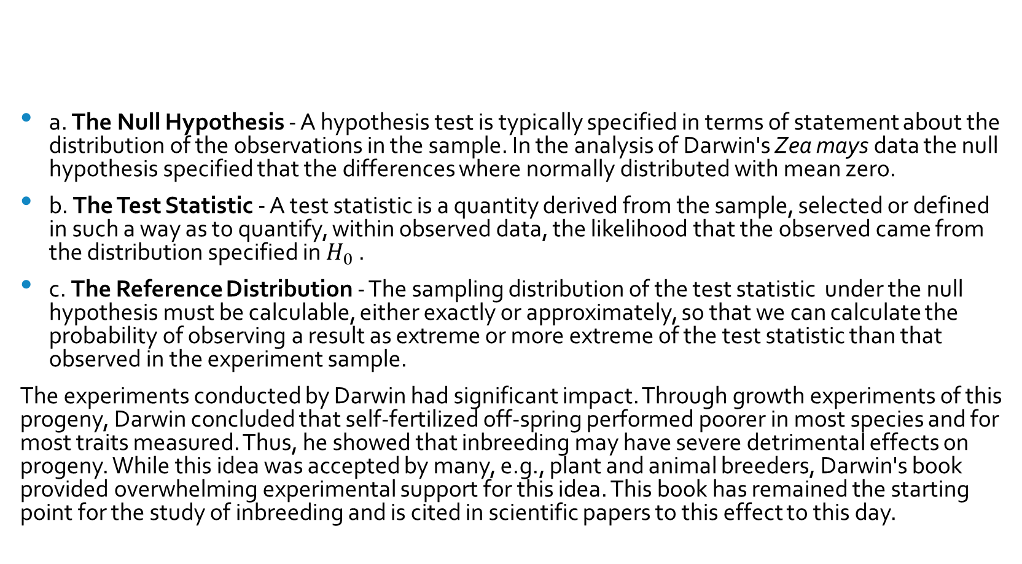
The Elements of a Statistical Test
a. The Null Hypothesis - A hypothesis test is typically specified in terms of statement about the distribution of the observations in the sample. In the analysis of Darwin's Zea mays data the null hypothesis specified that the differences where normally distributed with mean zero.
b. The Test Statistic - A test statistic is a quantity derived from the sample, selected or defined in such a way as to quantify, within observed data, the likelihood that the observed came from the distribution specified in $H_{0}$.
c. The Reference Distribution - The sampling distribution of the test statistic under the null hypothesis must be calculable, either exactly or approximately, so that we can calculate the probability of observing a result as extreme or more extreme of the test statistic than that observed in the experiment sample.
The experiments conducted by Darwin had significant impact. Through growth experiments of this progeny, Darwin concluded that self-fertilized off-spring performed poorer in most species and for most traits measured. Thus, he showed that inbreeding may have severe detrimental effects on progeny. While this idea was accepted by many, e.g., plant and animal breeders, Darwin's book provided overwhelming experimental support for this idea. This book has remained the starting point for the study of inbreeding and is cited in scientific papers to this effect to this day.

Slide 64
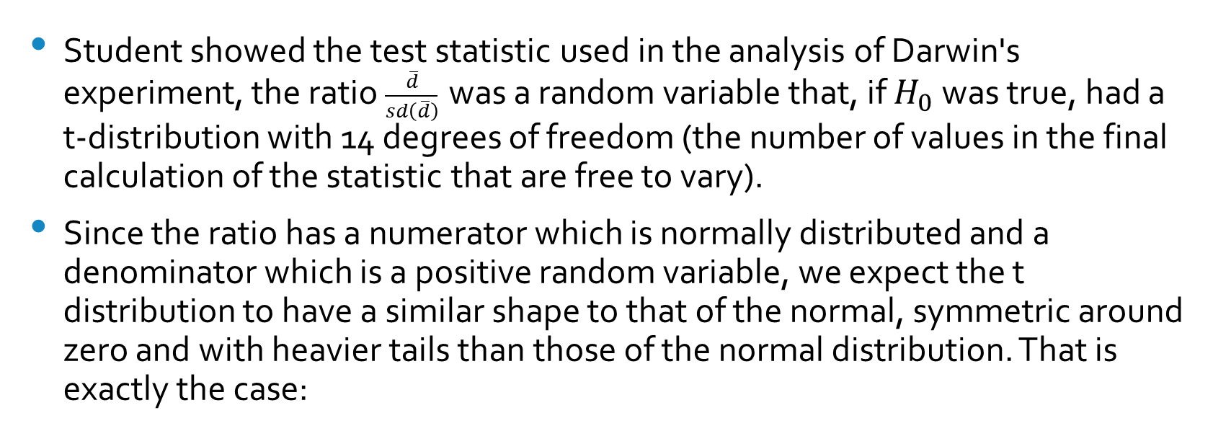
More on the t-test
Student showed the test statistic used in the analysis of Darwin's experiment, the ratio $\frac{\overline{d}}{sd\left(\overline{d}\right)}$ was a random variable that, if $H_{0}$ was true, had a t-distribution with 14 degrees of freedom (the number of values in the final calculation of the statistic that are free to vary).
Since the ratio has a numerator which is normally distributed and a denominator which is a positive random variable, we expect the t distribution to have a similar shape to that of the normal, symmetric around zero and with heavier tails than those of the normal distribution. That is exactly the case:

Slide 65
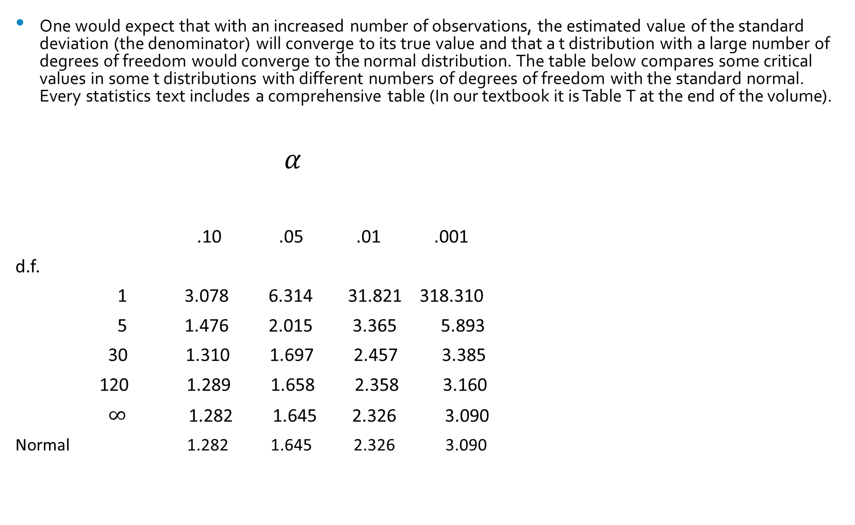
Critical Values
One would expect that with an increased number of observations, the estimated value of the standard deviation (the denominator) will converge to its true value and that a t distribution with a large number of degrees of freedom would converge to the normal distribution. The table below compares some critical values in some t distributions with different numbers of degrees of freedom with the standard normal. Every statistics text includes a comprehensive table (In our textbook it is Table T at the end of the volume).
$α$
.10 .05 .01 .001
d.f.
1 3.078 6.314 31.821 318.310
5 1.476 2.015 3.365 5.893
30 1.310 1.697 2.457 3.385
120 1.289 1.658 2.358 3.160
$∞$ 1.282 1.645 2.326 3.090
Normal 1.282 1.645 2.326 3.090

Slide 66
Alternatives to the t-test
After Fisher published his classic book in 1925 applying the t-test to Darwin's data, a number of statisticians pointed out that the results obtained were contingent on the assumption of normality for the differences between the heights of the plants in each pair and that this assumption was critical and could not be verified with such a small sample. Although he was dismissive of this criticism (in his view, made by people who had never carried out a real experiment), Fisher developed, in 1935, an alternative test that did not rely on the normality assumption.

Slide 67
A Permutation Test
Fisher reasoned as follows: if the heights of cross-fertilized and self-fertilized have the same distribution, i.e., the method of fertilization has no effect on the plant height, then there is an equal chance that the taller plant in each pair was fertilized by either method; this means that the outcome where the heights were swapped was equally likely if the null hypothesis was true.

Slide 68
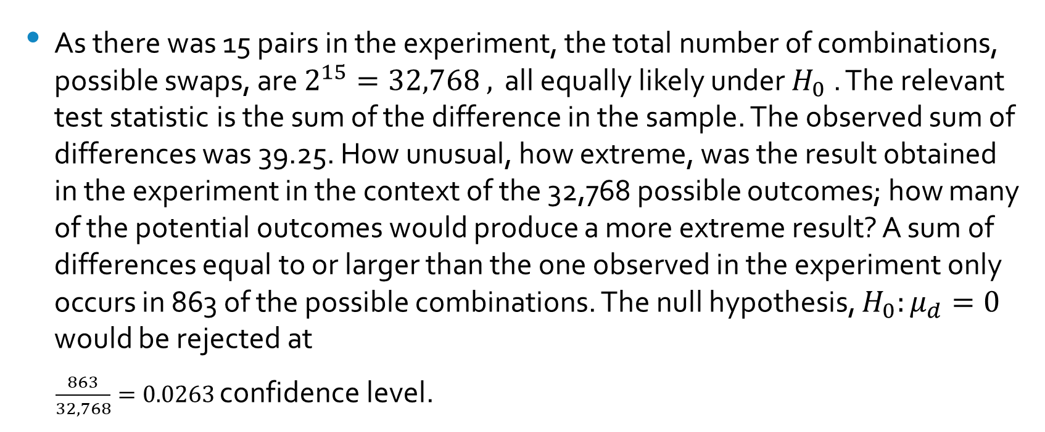
Calculating the p-value
As there was 15 pairs in the experiment, the total number of combinations, possible swaps, are $2^{15}=32,768 ,$ all equally likely under $H_{0}$. The relevant test statistic is the sum of the difference in the sample. The observed sum of differences was 39.25. How unusual, how extreme, was the result obtained in the experiment in the context of the 32,768 possible outcomes; how many of the potential outcomes would produce a more extreme result? A sum of differences equal to or larger than the one observed in the experiment only occurs in 863 of the possible combinations. The null hypothesis, $H_{0}:μ_{d}=0$ would be rejected at
$\frac{863}{32,768}=0.0263$ confidence level.

Slide 69
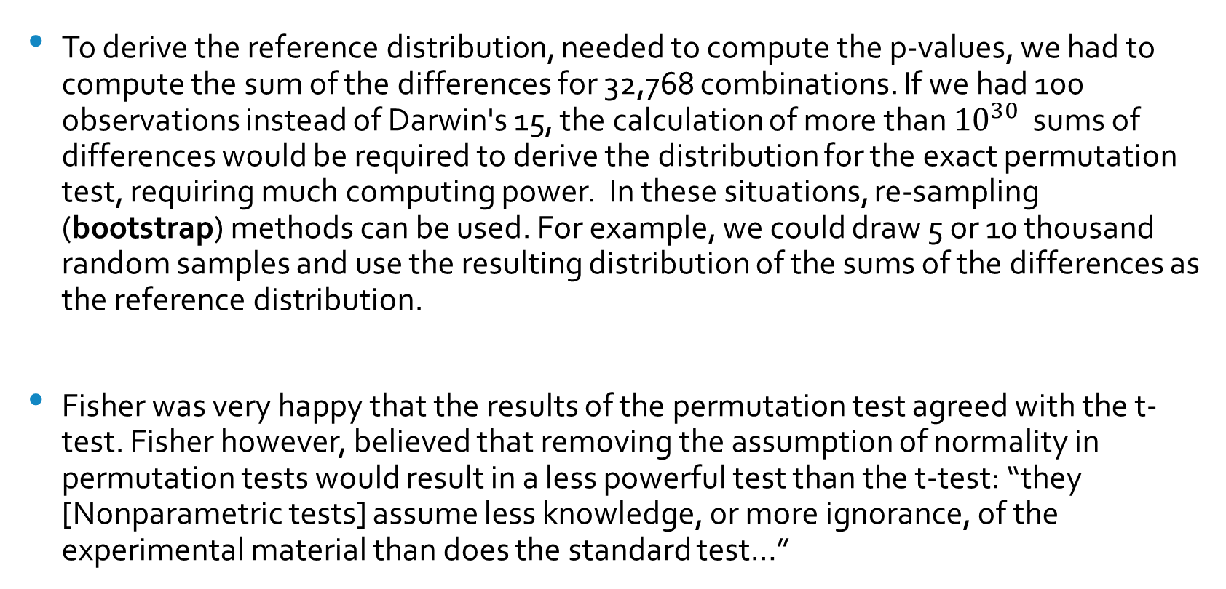
The Reference Distribution
To derive the reference distribution, needed to compute the p-values, we had to compute the sum of the differences for 32,768 combinations. If we had 100 observations instead of Darwin's 15, the calculation of more than ${10}^{30}$ sums of differences would be required to derive the distribution for the exact permutation test, requiring much computing power. In these situations, re-sampling (bootstrap) methods can be used. For example, we could draw 5 or 10 thousand random samples and use the resulting distribution of the sums of the differences as the reference distribution.
Fisher was very happy that the results of the permutation test agreed with the t-test. Fisher however, believed that removing the assumption of normality in permutation tests would result in a less powerful test than the t-test: “they [Nonparametric tests] assume less knowledge, or more ignorance, of the experimental material than does the standard test…”

Slide 70
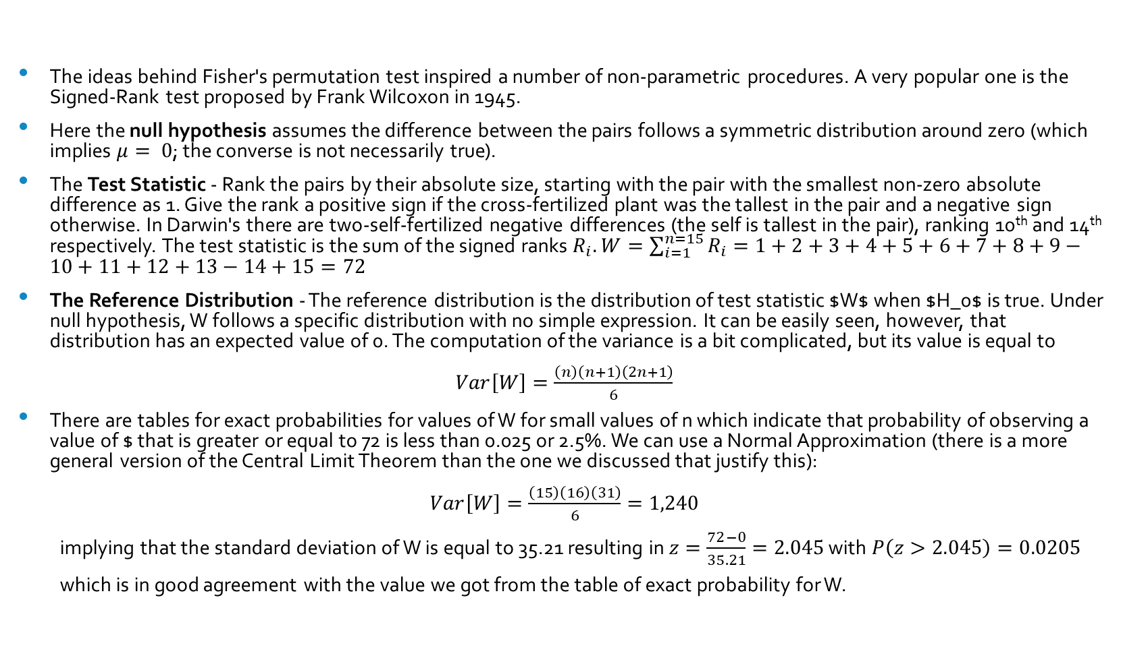
Another Alternative: The Wilcoxon Signed-Rank Test
The ideas behind Fisher's permutation test inspired a number of non-parametric procedures. A very popular one is the Signed-Rank test proposed by Frank Wilcoxon in 1945.
Here the null hypothesis assumes the difference between the pairs follows a symmetric distribution around zero (which implies $μ= 0$; the converse is not necessarily true).
The Test Statistic - Rank the pairs by their absolute size, starting with the pair with the smallest non-zero absolute difference as 1. Give the rank a positive sign if the cross-fertilized plant was the tallest in the pair and a negative sign otherwise. In Darwin's there are two-self-fertilized negative differences (the self is tallest in the pair), ranking 10th and 14th respectively. The test statistic is the sum of the signed ranks $R_{i}.$ $W=\sum_{i=1}^{n=15}{R_{i}}=1+2+3+4+5+6+7+8+9−10+11+12+13−14+15=72$
The Reference Distribution - The reference distribution is the distribution of test statistic $W$ when $H_0$ is true. Under null hypothesis, W follows a specific distribution with no simple expression. It can be easily seen, however, that distribution has an expected value of 0. The computation of the variance is a bit complicated, but its value is equal to
$Var\left[W\right]=\frac{\left(n\right)\left(n+1\right)\left(2n+1\right)}{6}$
There are tables for exact probabilities for values of W for small values of n which indicate that probability of observing a value of $ that is greater or equal to 72 is less than 0.025 or 2.5%. We can use a Normal Approximation (there is a more general version of the Central Limit Theorem than the one we discussed that justify this):
$Var\left[W\right]=\frac{\left(15\right)\left(16\right)\left(31\right)}{6}=1,240$
implying that the standard deviation of W is equal to 35.21 resulting in $z=\frac{72−0}{35.21}=2.045$ with $P\left(z>2.045\right)=0.0205$
which is in good agreement with the value we got from the table of exact probability for W.

Slide 71
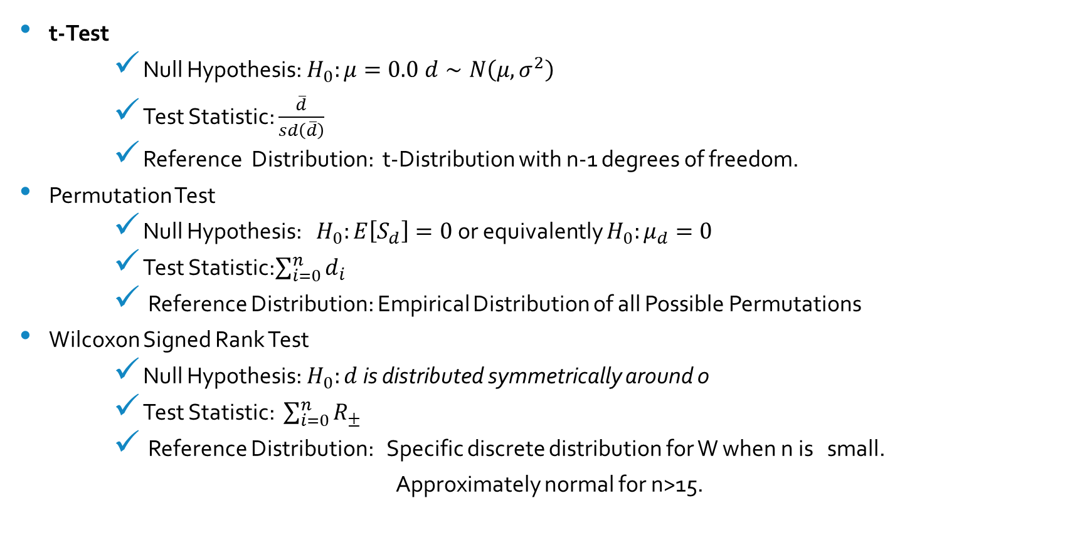
Comparing the Tests
t-Test
Null Hypothesis: $H_{0}:μ=0.0$ $d∼N\left(μ,σ^{2}\right)$
Test Statistic: $\frac{\overline{d}}{sd\left(\overline{d}\right)}$
Reference Distribution: t-Distribution with n-1 degrees of freedom.
Permutation Test
Null Hypothesis: $H_{0}:E\left[S_{d}\right]=0$ or equivalently $H_{0}:μ_{d}=0$
Test Statistic:$\sum_{i=0}^{n}{d_{i}}$
Reference Distribution: Empirical Distribution of all Possible Permutations
Wilcoxon Signed Rank Test
Null Hypothesis: $H_{0}:d$ is distributed symmetrically around 0
Test Statistic: $\sum_{i=0}^{n}{R_{±}}$
Reference Distribution: Specific discrete distribution for W when n is small.
Approximately normal for n>15.

Slide 72
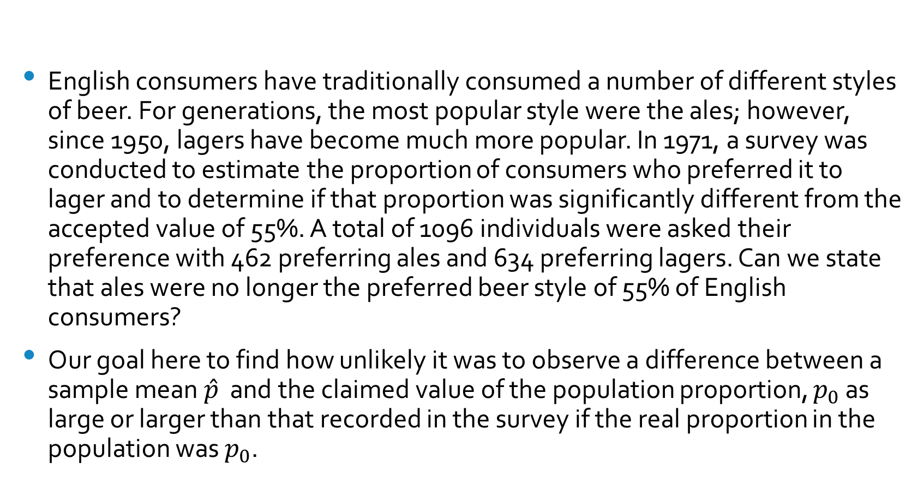
Hypothesis Test for a Population Proportion
English consumers have traditionally consumed a number of different styles of beer. For generations, the most popular style were the ales; however, since 1950, lagers have become much more popular. In 1971, a survey was conducted to estimate the proportion of consumers who preferred it to lager and to determine if that proportion was significantly different from the accepted value of 55%. A total of 1096 individuals were asked their preference with 462 preferring ales and 634 preferring lagers. Can we state that ales were no longer the preferred beer style of 55% of English consumers?
Our goal here to find how unlikely it was to observe a difference between a sample mean $\hat{p}$ and the claimed value of the population proportion, $p_{0}$ as large or larger than that recorded in the survey if the real proportion in the population was $p_{0}$.

Slide 73
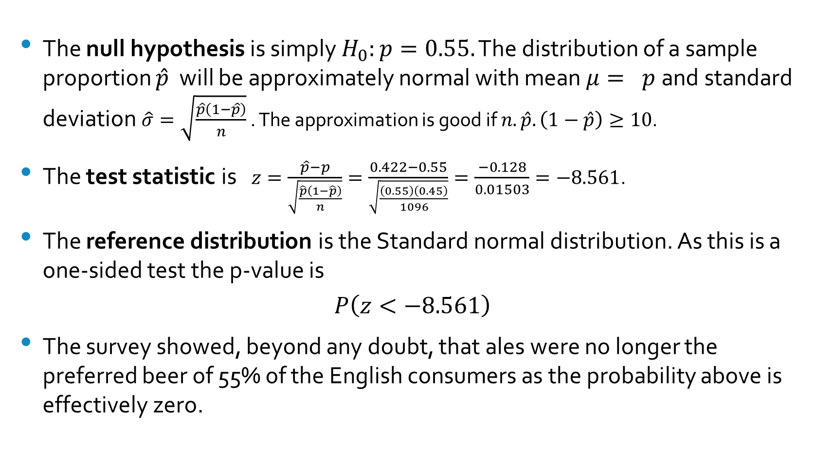
The Null Hypothesis, the Test Statistic and the Reference Distribution
The null hypothesis is simply $H_{0}:p=0.55.$ The distribution of a sample proportion $\hat{p}$ will be approximately normal with mean $μ= p$and standard deviation $\hat{σ}=\sqrt{\frac{\hat{p}\left(1−\hat{p}\right)}{n}}$ . The approximation is good if $n.\hat{p}.\left(1−\hat{p}\right)≥10$.
The test statistic is $z=\frac{\hat{p}−p}{\sqrt{\frac{\hat{p}\left(1−\hat{p}\right)}{n}}}=\frac{0.422−0.55}{\sqrt{\frac{\left(0.55\right)\left(0.45\right)}{1096}}}=\frac{−0.128}{0.01503}=−8.561$.
The reference distribution is the Standard normal distribution. As this is a one-sided test the p-value is
$$P\left(z<−8.561\right)$$
The survey showed, beyond any doubt, that ales were no longer the preferred beer of 55% of the English consumers as the probability above is effectively zero.

Slide 74
Confidence Intervals
In many business situations, one only needs an estimate for the preference proportion with some measure of the uncertainty associated with the estimate. What we need to know is: How close to the true value is the estimate. We want something simple indicating the accuracy of the estimate. This is what confidence intervals provide.
Definition -A confidence interval gives an estimated range of values which is likely to include an unknown population parameter, the estimated range being calculated from a given set of sample data.
Beer preferences revisited - In the example discussed earlier above, only 42.2% of the English consumers in the sample indicated a preference for the traditional ales. How accurate is this estimate? The appropriate response hinges on the distribution of the estimate.

Slide 75
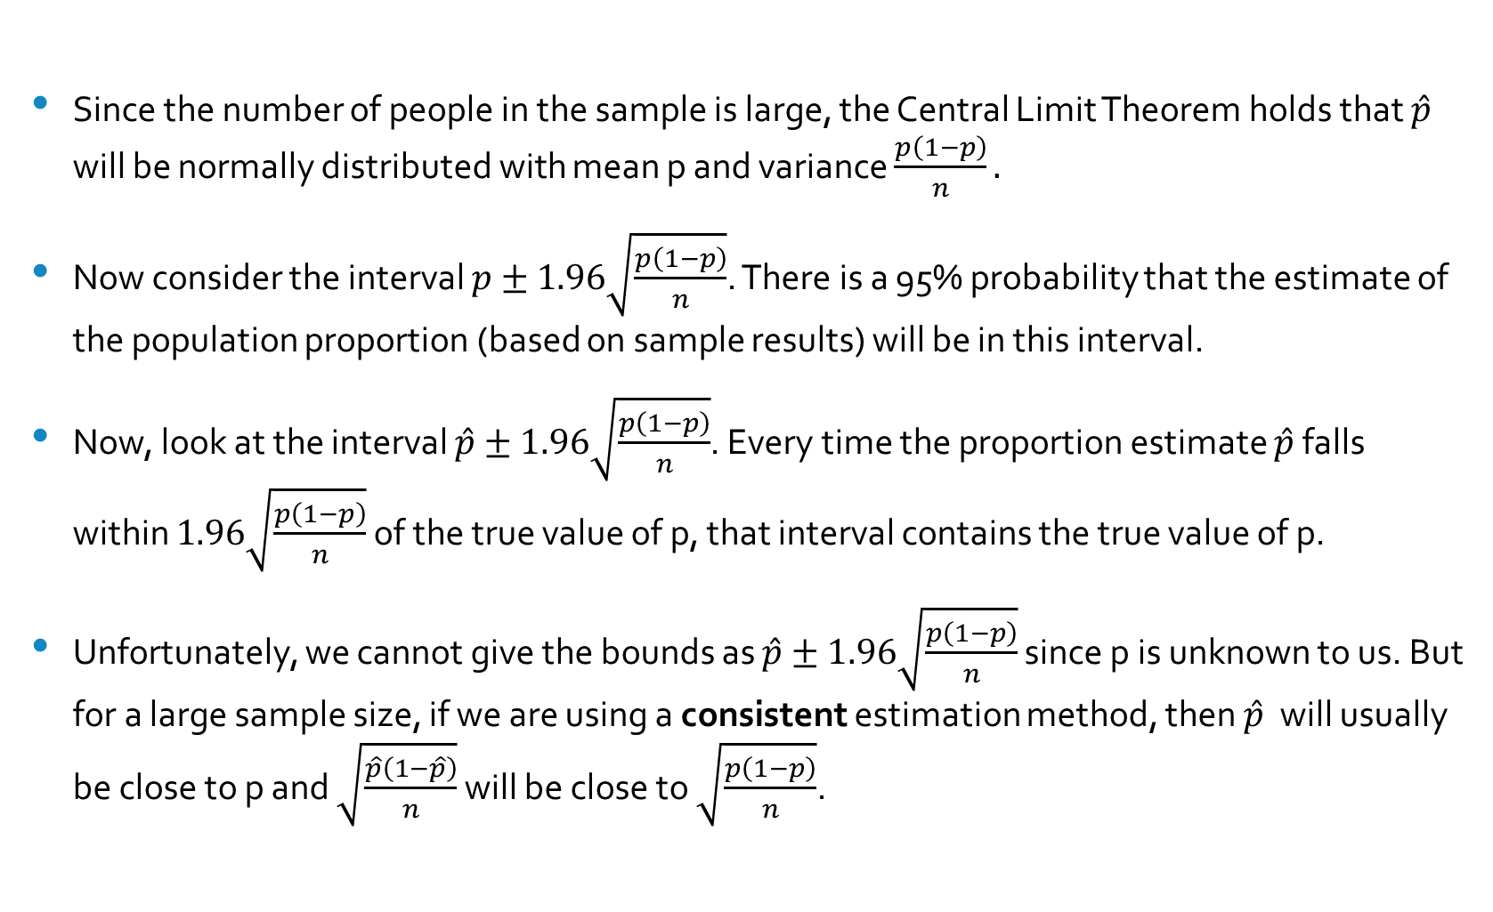
Calculating the Confidence Interval
Since the number of people in the sample is large, the Central Limit Theorem holds that $\hat{p}$ will be normally distributed with mean p and variance $\frac{p\left(1−p\right)}{n}.$
Now consider the interval $p±1.96\sqrt{\frac{p\left(1−p\right)}{n}}$. There is a 95% probability that the estimate of the population proportion (based on sample results) will be in this interval.
Now, look at the interval $\hat{p}±1.96\sqrt{\frac{p\left(1−p\right)}{n}}$. Every time the proportion estimate $\hat{p}$ falls within $1.96\sqrt{\frac{p\left(1−p\right)}{n}}$ of the true value of p, that interval contains the true value of p.
Unfortunately, we cannot give the bounds as $\hat{p}±1.96\sqrt{\frac{p\left(1−p\right)}{n}}$ since p is unknown to us. But for a large sample size, if we are using a consistent estimation method, then $\hat{p}$ will usually be close to p and $\sqrt{\frac{\hat{p}\left(1−\hat{p}\right)}{n}}$ will be close to $\sqrt{\frac{p\left(1−p\right)}{n}}$.

Slide 76
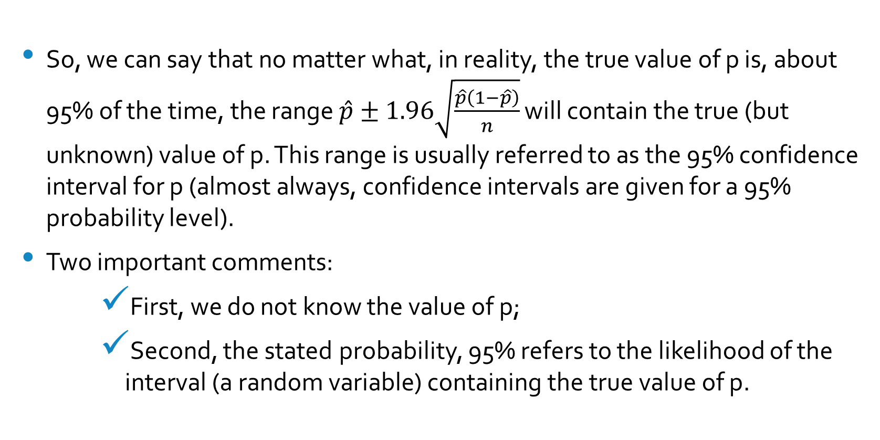
Conclusion
So, we can say that no matter what, in reality, the true value of p is, about 95% of the time, the range $\hat{p}±1.96\sqrt{\frac{\hat{p}\left(1−\hat{p}\right)}{n}}$ will contain the true (but unknown) value of p. This range is usually referred to as the 95% confidence interval for p (almost always, confidence intervals are given for a 95% probability level).
Two important comments:
First, we do not know the value of p;
Second, the stated probability, 95% refers to the likelihood of the interval (a random variable) containing the true value of p.

Slide 77
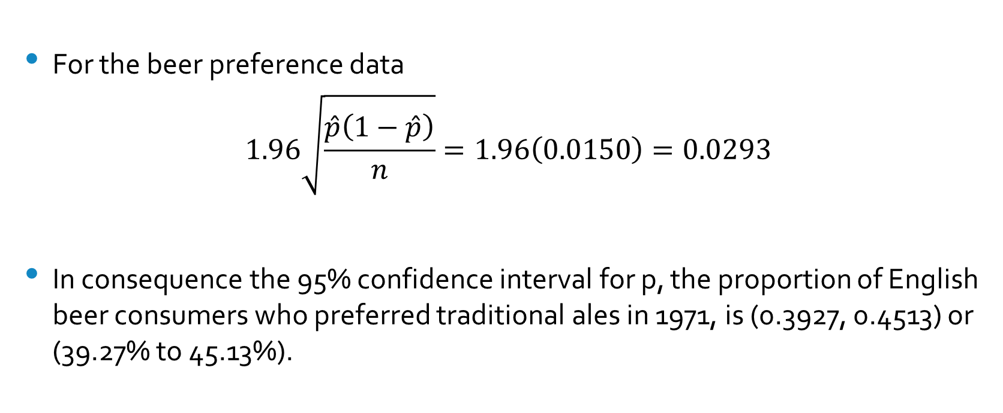
Example-Beer Preferences
For the beer preference data
$$1.96\sqrt{\frac{\hat{p}\left(1−\hat{p}\right)}{n}}=1.96\left(0.0150\right)=0.0293$$
In consequence the 95% confidence interval for p, the proportion of English beer consumers who preferred traditional ales in 1971, is (0.3927, 0.4513) or (39.27% to 45.13%).

Slide 78
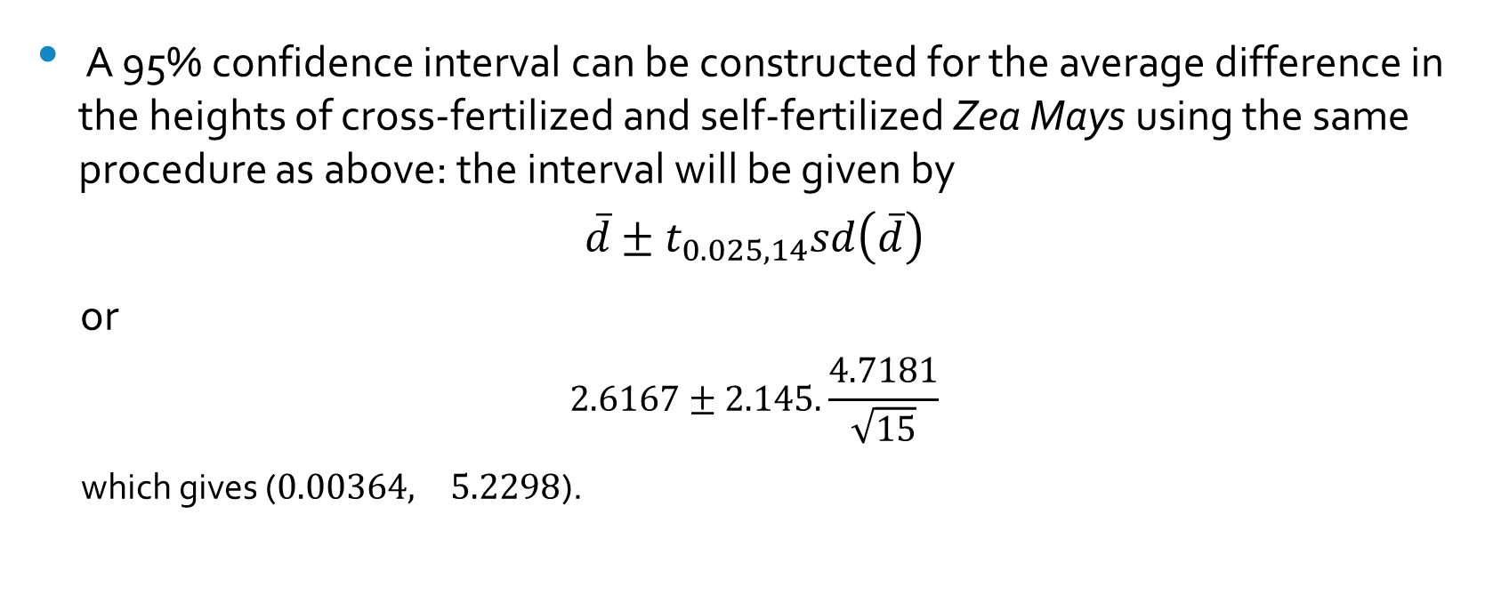
Example – Zea Mays heights
A 95% confidence interval can be constructed for the average difference in the heights of cross-fertilized and self-fertilized Zea Mays using the same procedure as above: the interval will be given by
$$\overline{d}±t_{0.025,14}sd\left(\overline{d}\right)$$
or
$$2.6167±2.145.\frac{4.7181}{\sqrt{15}}$$
which gives ($0.00364, 5.2298$).

Slide 79
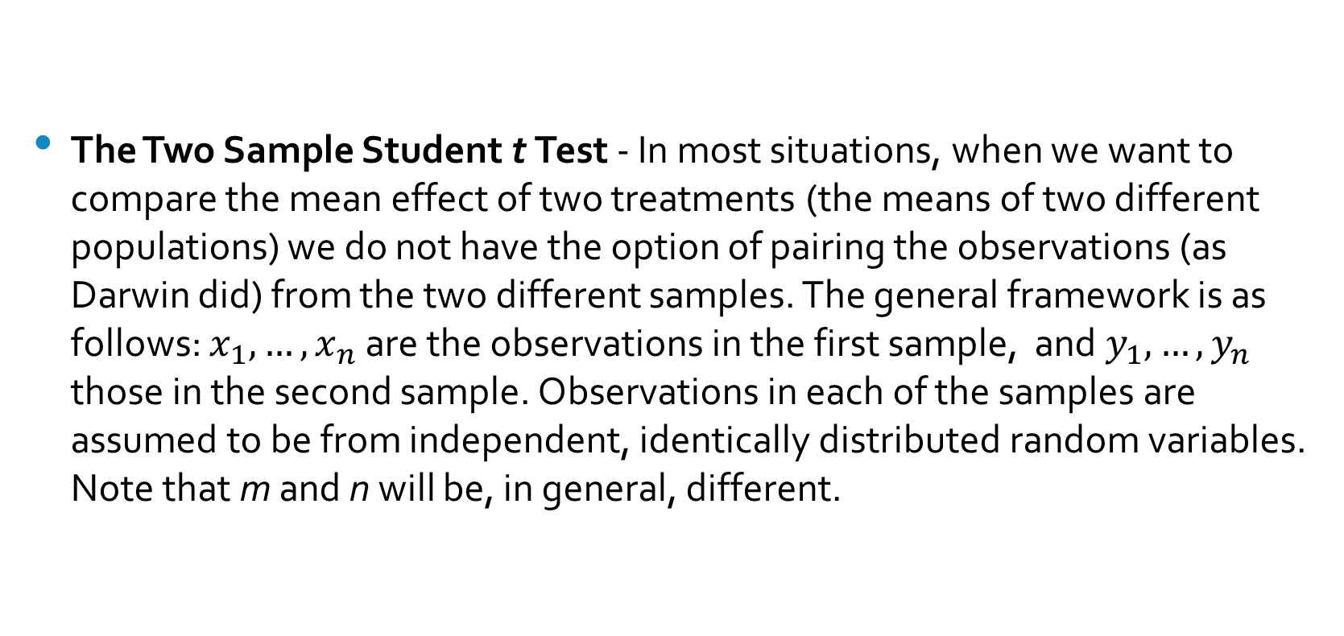
The Two-Sample Problem
The Two Sample Student t Test - In most situations, when we want to compare the mean effect of two treatments (the means of two different populations) we do not have the option of pairing the observations (as Darwin did) from the two different samples. The general framework is as follows: $x_{1},…,x_{n}$are the observations in the first sample, and $y_{1},…,y_{n}$ those in the second sample. Observations in each of the samples are assumed to be from independent, identically distributed random variables. Note that m and n will be, in general, different.

Slide 80
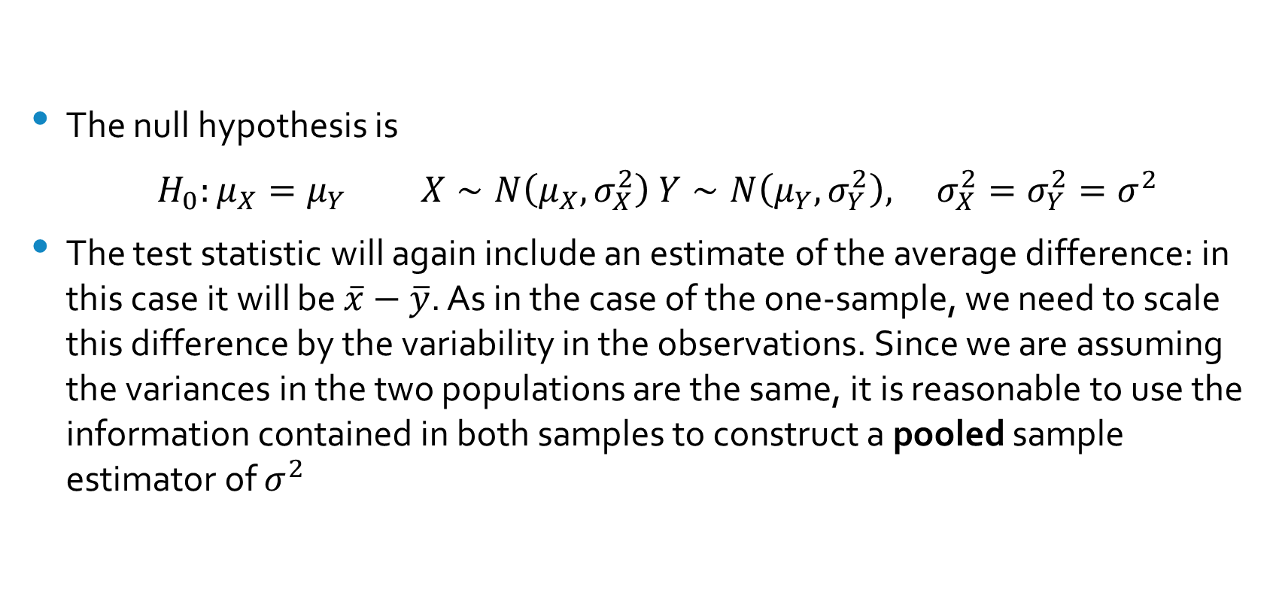
The null hypothesis
The null hypothesis is
$H_{0}:μ_{X}=μ_{Y}$ $X∼N\left(μ_{X},σ_{X}^{2}\right)$ $Y∼N\left(μ_{Y},σ_{Y}^{2}\right),$ $σ_{X}^{2}=σ_{Y}^{2}=σ^{2}$
The test statistic will again include an estimate of the average difference: in this case it will be $\overline{x}−\overline{y}$. As in the case of the one-sample, we need to scale this difference by the variability in the observations. Since we are assuming the variances in the two populations are the same, it is reasonable to use the information contained in both samples to construct a pooled sample estimator of $σ^{2}$

Slide 81
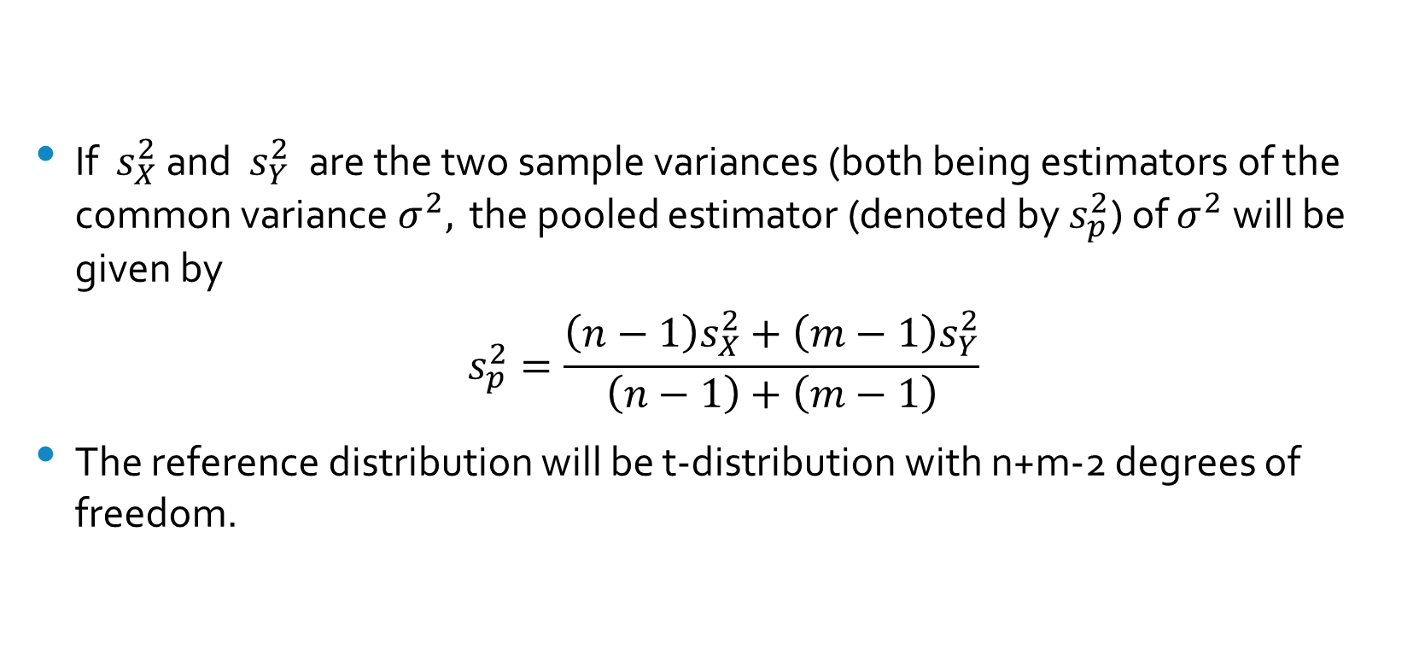

The Pooled Estimator of $σ^{2}$
If $s_{X}^{2}$ and $s_{Y}^{2}$ are the two sample variances (both being estimators of the common variance $σ^{2},$ the pooled estimator (denoted by $s_{p}^{2}$) of $σ^{2}$will be given by
$$s_{p}^{2}=\frac{\left(n−1\right)s_{X}^{2}+\left(m−1\right)s_{Y}^{2}}{\left(n−1\right)+\left(m−1\right)}$$
The reference distribution will be t-distribution with n+m-2 degrees of freedom.

Slide 82
Example
In a comparative study of fuel efficiency of cars manufactured in the United States and cars sold in the United States but manufactured in Japan, two sample were selected. Data collected included fuel efficiency, measured in miles per gallon for U.S. cars (sample 1) and for Japanese cars (sample 2); the summary statistics for each sample are shown below:
SAMPLE 1:
NUMBER OF OBSERVATIONS = 249
MEAN = 20.14458
STANDARD DEVIATION = 6.41470
STANDARD ERROR OF THE MEAN = 0.40652
SAMPLE 2:
NUMBER OF OBSERVATIONS = 79
MEAN = 30.48101
STANDARD DEVIATION = 6.10771
STANDARD ERROR OF THE MEAN = 0.68717

Slide 83
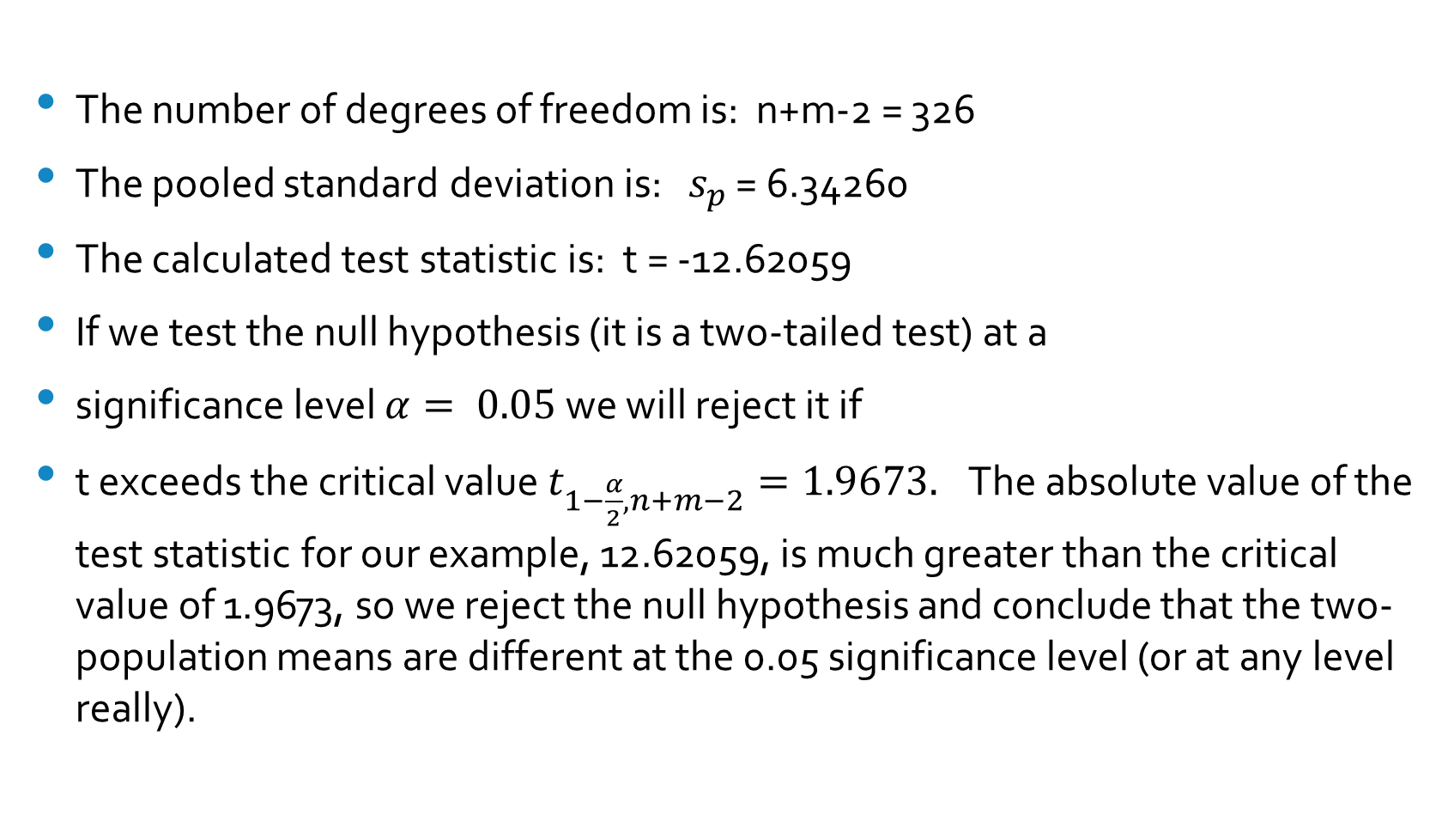
Analysis
The number of degrees of freedom is: n+m-2 = 326
The pooled standard deviation is: $s_{p}$ = 6.34260
The calculated test statistic is: t = -12.62059
If we test the null hypothesis (it is a two-tailed test) at a
significance level $α= 0.05$we will reject it if
t exceeds the critical value $t_{1−\frac{α}{2},n+m−2}=1.9673.$ The absolute value of the test statistic for our example, 12.62059, is much greater than the critical value of 1.9673, so we reject the null hypothesis and conclude that the two-population means are different at the 0.05 significance level (or at any level really).

Slide 84
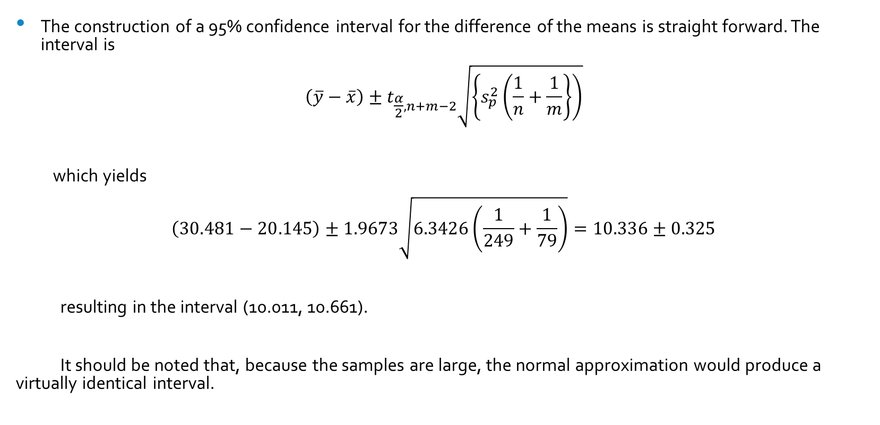
Confidence Interval
The construction of a 95% confidence interval for the difference of the means is straight forward. The interval is
$$\left(\overline{y}−\overline{x}\right)±t_{\frac{α}{2},n+m−2}\sqrt{\left\{s_{p}^{2}\left(\frac{1}{n}+\frac{1}{m}\right\}\right)}$$
which yields
$$\left(30.481−20.145\right)±1.9673\sqrt{6.3426\left(\frac{1}{249}+\frac{1}{79}\right)}=10.336±0.325$$
resulting in the interval (10.011, 10.661).
It should be noted that, because the samples are large, the normal approximation would produce a virtually identical interval.

Slide 85
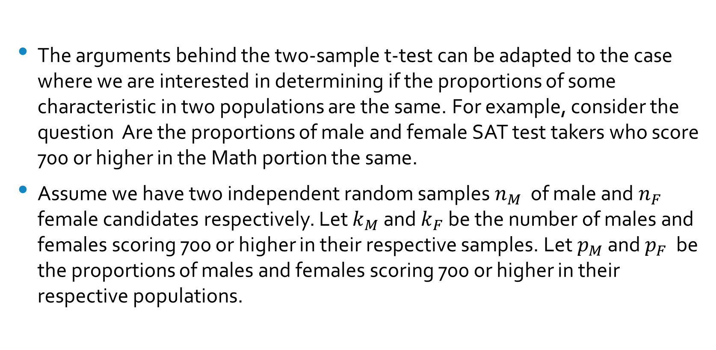
Testing if Two Proportions Are the Same
The arguments behind the two-sample t-test can be adapted to the case where we are interested in determining if the proportions of some characteristic in two populations are the same. For example, consider the question Are the proportions of male and female SAT test takers who score 700 or higher in the Math portion the same.
Assume we have two independent random samples $n_{M}$ of male and $n_{F}$ female candidates respectively. Let $k_{M}$ and $k_{F}$ be the number of males and females scoring 700 or higher in their respective samples. Let $p_{M}$ and $p_{F}$ be the proportions of males and females scoring 700 or higher in their respective populations.

Slide 86
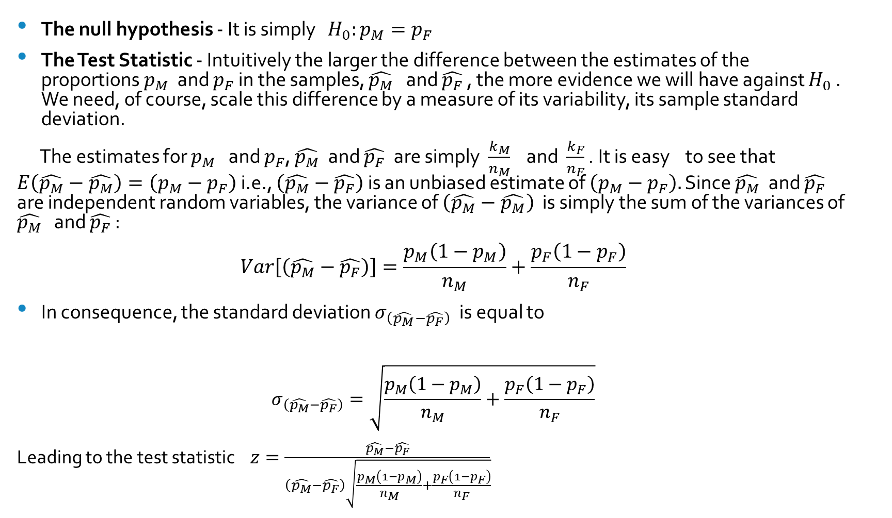
Analysis
The null hypothesis - It is simply $H_{0}:p_{M}=p_{F}$
The Test Statistic - Intuitively the larger the difference between the estimates of the proportions $p_{M}$ and $p_{F}$ in the samples, $\hat{p_{M}}$ and $\hat{p_{F}}$ , the more evidence we will have against $H_{0}$. We need, of course, scale this difference by a measure of its variability, its sample standard deviation.
The estimates for $p_{M}$ and $p_{F}$, $\hat{p_{M}}$ and $\hat{p_{F}}$ are simply $\frac{k_{M}}{n_{M}}$ and $\frac{k_{F}}{n_{F}}$ . It is easy to see that $E\left(\hat{p_{M}}−\hat{p_{M}}\right)=\left(p_{M}−p_{F}\right)$ i.e., $\left(\hat{p_{M}}−\hat{p_{F}}\right)$ is an unbiased estimate of $\left(p_{M}−p_{F}\right).$ Since $\hat{p_{M}}$ and $\hat{p_{F}}$ are independent random variables, the variance of $\left(\hat{p_{M}}−\hat{p_{M}}\right)$ is simply the sum of the variances of $\hat{p_{M}}$ and $\hat{p_{F}}$ :
$$Var\left[\left(\hat{p_{M}}−\hat{p_{F}}\right)\right]=\frac{p_{M}\left(1−p_{M}\right)}{n_{M}}+\frac{p_{F}\left(1−p_{F}\right)}{n_{F}}$$
In consequence, the standard deviation $σ_{\left(\hat{p_{M}}−\hat{p_{F}}\right)}$ is equal to
$$σ_{\left(\hat{p_{M}}−\hat{p_{F}}\right)}=\sqrt{\frac{p_{M}\left(1−p_{M}\right)}{n_{M}}+\frac{p_{F}\left(1−p_{F}\right)}{n_{F}}}$$
Leading to the test statistic $z=\frac{\hat{p_{M}}−\hat{p_{F}}}{\left(\hat{p_{M}}−\hat{p_{F}}\right)\sqrt{\frac{p_{M}\left(1−p_{M}\right)}{n_{M}}+\frac{p_{F}\left(1−p_{F}\right)}{n_{F}}}}$

Slide 87
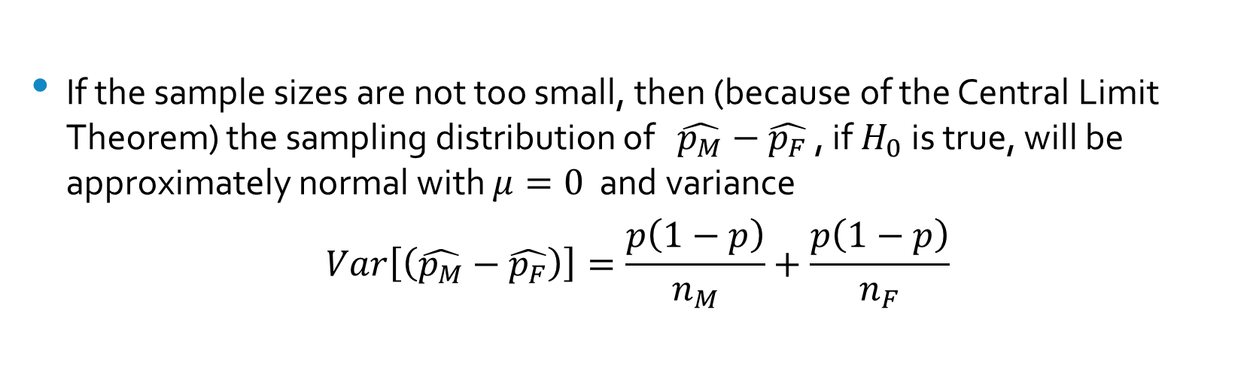
The Reference Distribution
If the sample sizes are not too small, then (because of the Central Limit Theorem) the sampling distribution of $\hat{p_{M}}−\hat{p_{F}}$ , if $H_{0}$ is true, will be approximately normal with $μ=0$ and variance
$$Var\left[\left(\hat{p_{M}}−\hat{p_{F}}\right)\right]=\frac{p\left(1−p\right)}{n_{M}}+\frac{p\left(1−p\right)}{n_{F}}$$

Slide 88

Example
Example - Two samples of SAT takers in 2016 were selected, the first with 762 males of which 72 scored 700 or higher, and the second with 875 females of which 45 scored 700 or higher.
$z=\frac{\frac{72}{762}−\frac{45}{875}}{\sqrt{\frac{\frac{72}{762}\left(1−\frac{72}{762}\right)}{762}+\frac{\frac{45}{875}\left(1−\frac{45}{875}\right)}{875}}}$
which yields
$$z=\frac{0.0431}{0.01296}=3.3256$$
resulting in a p-value of P(z> 3.3256) = 2 (0.00044) = 0.00088 (it is a two-tailed test) or 0.088%..
A 95% confidence interval for the difference is given by $0.0431±1.960\left(0.01296\right)$
(0.01770, 0.6850) or (1.770%, 6.850%)

Slide 89
A Two-Sample t-Test Worked-out Example
A preliminary study to compare the effectiveness of two cholesterol lowering drugs in patients with very levels of cholesterol produced the following results (patients were randomly allocated to the two groups);
X Y
98 58
110 24
68 87
93 89
68 31
50 62
38 23
91 53
81 32
78
83

Slide 90

The Three Components of the Test
We would like to know if there is enough evidence to reject the hypothesis that there is no difference in the average effect of the two drugs. We will make the assumptions that the results in each sample come from normal distributions which have the same variance. The null hypothesis $H_{0}$ is then
$H_{0}:μ_{X}=μ_{Y}$ $X∼N\left(μ_{X},σ_{X}^{2}\right)$ $Y∼N\left(μ_{Y},σ_{Y}^{2}\right)$ $σ_{X}^{2}=σ_{Y}^{2}=σ^{2}$
The relevant quantities are the sample means and the estimate for the variance of the observations. Let $\hat{μ_{X}}$ and $\hat{μ_{Y}}$ be the sample means. Their distributions are assumed to be normal, with expected values $μ_{X}$ and $μ_{Y}$ respectively; under $H_{0}$ they are assumed to be the same. Their variances are $\frac{σ_{X}^{2}}{n}$ and $\frac{σ_{Y}^{2}}{m}$ . In our example n=11 and m=9. We are assuming however that the observation in both groups have the same variance; in consequence we can get a combined estimate of the variance using the observations in both samples.

Slide 91

The Pooled Variance Estimate
Let $\hat{s_{X}^{2}}=\frac{\sum_{1}^{n}{{\left(x_{i}−\hat{μ_{X}}\right)}^{2}}}{n−1}$ be the estimate for the variance in the first sample and $\hat{s_{Y}^{2}}=\frac{\sum_{1}^{n}{{\left(y_{i}−\hat{μ_{Y}}\right)}^{2}}}{m−1}$ be the estimate for the variance in the second sample. A pooled estimate for the variance can be obtained by
$\hat{s^{2}}=$ $\frac{\left(n−1\right)\hat{s_{X}^{2}}+\left(m−1\right)\hat{s_{Y}^{2}}}{n+m−2}=$ $\frac{\sum{{\left(x_{i}−\hat{μ_{X}}\right)}^{2}}+\sum{{\left(y_{i}−\hat{μ_{Y}}\right)}^{2}}}{n+m−2}$
Using the sample data above we get:
$$\hat{μ_{X}}=\frac{98+110+68+93+68+50+38+91+81+78+83}{11}=78$$
and
$\hat{μ_{Y}}=\frac{58+24+87+89+31+62+23+53+32}{9}=51$

Slide 92

The Pooled Variance Estimate (2)
The pooled variance estimate is then
$\hat{s^{2}}=\frac{{\left(98−78\right)}^{2}…{\left(83−78\right)}^{2}+{\left(58−51\right)}^{2}+…+{\left(32−51\right)}^{2}}{18}=\frac{9432}{18}=524$
resulting in the pooled estimate for the standard deviation of the observations:
$$\hat{s}=\sqrt{524}=22.89$$

Slide 93

The Test Statistic
The test statistic is the ratio of the estimated difference (a random variable as this is calculated from the observed results in the samples) and an estimate of its standard deviation (also a random variable):
$$\frac{\hat{μ_{X}}−\hat{μ_{Y}}}{\hat{s_{\left(\hat{μ_{X}}−\hat{μ_{Y}}\right)}}}$$
Because $\hat{μ_{X}}$ and $\hat{μ_{Y}}$ are independent variables and $Var\left[\hat{μ_{X}}\right]$ = $Var\left[\hat{μ_{Y}}\right],$ the variance of $\hat{μ_{X}}−\hat{μ_{Y}}$is
$$Var\left[\hat{μ_{X}}−\hat{μ_{Y}}\right]=Var\left[\hat{μ_{X}}\right]+Var\left[\hat{μ_{Y}}\right]$$
In consequence,
$$Var\left[\hat{μ_{X}}−\hat{μ_{Y}}\right]=\frac{σ^{2}}{n}+\frac{σ^{2}}{m}$$
and the estimated standard deviation of $\hat{μ_{X}}−\hat{μ_{Y}}$
$$σ\sqrt{\left(\frac{1}{n}+\frac{1}{m}\right)}$$

Slide 94

The Test Statistic (2)
Substituting $σ$ (which we do not know) by its estimate $\hat{s}$ the test statistic becomes
$$t=\frac{\hat{μ_{X}}−\hat{μ_{Y}}}{\hat{s}\sqrt{\left(\frac{1}{n}+\frac{1}{m}\right)}}$$
The numerator in the test statistic is
$\hat{μ_{X}}−\hat{μ_{Y}}=78−51=27$
and the denominator
$$22.89\sqrt{\left(\frac{1}{11}+\frac{1}{9}\right)}=10.28$$
resulting in a t-ratio equal to 2.624.

Slide 95

Reference Distribution and Significance Level
The reference distribution will be the t-distribution with n+m-2 degrees of freedom. Since $t_{18,0.975}=2.101$ and $t_{18,0.995}=2.878$ we would reject the null hypothesis at a 5% level of significance but not at the 1% level.

Slide 96

Confidence Interval
The 95% confidence interval for $μ_{X}−μ_{Y}$ is given by
$$\left(\hat{μ_{X}}−\hat{μ_{Y}}\right)±t_{18,0.975}=\left(78−51\right)±2.101\left(10.28\right)=27±21.60$$
or (5.4, 48.6).

Slide 97

Multinomial Experiments and $χ^{2}$Distribution
A natural extension of binomial experiments (where there are only two possible outcomes) is one where there is a number $k, k≥3$ of possible outcomes. These are referred to as multinomial experiments.
The experiment consists of n repeated trials.
Each trial has a discrete number k of possible outcomes.
On any given trial, the probability that a particular outcome will occur is constant.
The probabilities of the k outcomes, denoted by $p_{1},p_{2},…,p_{k}$are such that
$p_{1}+p_{2}=…+p_{k}=1$
The trials are independent; that is, the outcome on one trial does not affect the outcome on other trials.
The random variables of interest are the cell counts, $n_{1},n_{2},…,n_{k}$ the number of observations that fall in each of the k classes.

Slide 98

Testing a Multinomial Model
The Null Hypothesis is $H_{0}:p_{1}=p_{1,0},p_{2}=p_{2,0},…,p_{k}=p_{k,0}$
$p_{1,0}+p_{2,0}=…+p_{k,0}=1$
The Test Statistic -If the null hypothesis is true, then we expect the number of times the $i^{th}$ category is observed to be close to $n.p_{i,0}$ , the expected number $E_{i}$. The larger the difference between the number of observed frequency in the $i^{th}$ cell and the expected value the more evidence we will have against the null hypothesis. If we were to add the observed differences over all k the result would be always zero. Instead, we consider the square of the differences ${\left(n_{i}−E_{1}\right)}^{2}$. Of course, this squared difference has to be scaled by the expected frequency itself. As result a reasonable test statistic would be
$$χ^{2}=\sum{\frac{{\left(n_{i}−E_{i}\right)}^{2}}{E_{i}}}$$

Slide 99

Testing a Multinomial Model (Continued)
The Reference Distribution - It can be shown that, if the $H_{0}$ is true, the test statistic has a $χ^{2}$ distribution with (k-1) degrees of freedom.
Note that this test is a one-tail test: one only rejects the null hypothesis if the observed value of the test statistic is very large, i.e., $χ^{2}>χ_{α}^{2}$ where
$$P\left(χ^{2}>χ_{α}^{2}\right)=α$$
The $χ^{2}$ distribution with k degrees of freedom is the distribution of a sum of the squares of k independent standard normal random variables.
Its expectation is, obviously, $E\left[χ_{k}^{2}\right]=k$ it can be shown that its variance $Var\left[χ_{k}^{2}\right]=2k .$ The figure in the next slide shows the shape of the distribution for a few different numbers of degrees of freedom.

Slide 100

The $χ^{2}$ Distribution

Slide 101

Example
Among 3,564 new recruits in the British Army, 2,801 were from England, 408 were from Scotland, 226 from Wales and 129 from Northern Ireland. Did the origin mix of the recruits match the general population? The population of Britain is 63.2 million, 53.0 million in England, 5.3 million in Scotland, 3.1 million in Wales and 1.8 million in Northern Ireland. If the mix in the recruits matched the general population one would expect 2988 to be from England, 299 from Scotland, 176 from Wales and 101 from Northern Ireland. Are the differences between the frequencies in the Army recruits and the general population due to chance?
The test statistic is
$χ^{2}=\sum_{i=1}^{4}{\frac{{\left(n_{i}−E_{i}\right)}^{2}}{E_{i}}}=\frac{{\left(2801−2988\right)}^{2}}{2988}+\frac{{\left(408−299\right)}^{2}}{299}+\frac{{\left(226−176\right)}^{2}}{176}+\frac{{\left(129−101\right)}^{2}}{101}$
$=\frac{34969}{2988}+\frac{11881}{299}+\frac{2500}{176}+\frac{784}{101}=73.39$
From a table at the end of the textbook, we can see that the critical value for $α= 0.005$ $ in the $χ^{2}$ distribution with 3 degrees of freedom is 12.838. In consequence we have to conclude that the mix among recruits does not match the general population.

Slide 102

Deriving the Reference Distribution (Can be skipped)
To show that the test statistic defined earlier $χ^{2}=\sum{\frac{{\left(n_{i}−E_{i}\right)}^{2}}{E_{i}}}$has an approximately $χ_{k}^{2}$ distribution, Karl Pearson argued as follows: De Moivre and Laplace established that a binomial distribution could be approximated by a normal distribution. Specifically, they showed the asymptotic normality of the random variable
$\frac{m−Np}{\sqrt{Npq}}$
where N is the number of trials, p is the probability of success in each trial and $m$ is the number of successes observed in the N trials.
Obviously, the square of this variable, $\frac{{\left(m−Np\right)}^{2}}{Npq}$ is $χ_{1}^{2}$
which can be re-written as $q.χ^{2}=\frac{{\left(m−Np\right)}^{2}}{Np}$
Using N=N p + N(1-p), N=m+(N-m), and q=1-p we have
$p.χ^{2}=\frac{{\left(N−m−Nq\right)}^{2}}{Nq}$
and
$χ^{2}=\frac{{\left(m−Np\right)}^{2}}{Np}+\frac{{\left(N−m−Nq\right)}^{2}}{Nq}$ which proves the case k=2.
The extension to the general case (when k>2) is straightforward albeit very tedious.

Slide 103

Contingency Tables and Measures of Association
Contingency tables display the two-way (or much less frequently, the multivariate) frequency distribution of the variables of interest.
Example - In a paper published in 1987, using data collected in a large (3891 subjects) prospective study conducted in the Yale-New Haven Hospital between 1980 and 1982, investigators looked at the consumption of caffeine and marital status of antenatal patients. The data is summarized in the table below.
Marital Status and Caffeine Consumption

Slide 104

Questions
The first question is whether there is some association between marital status and caffeine consumption, or the variables are independent.. If there is no association between the variables, the proportions of caffeine consumption, None, Moderate, Average and Heavy should be approximately the same across the groups of Married, Divorced and Single women.
Let $n_{i.}$be the marginal total row frequency and $n_{.i}$ be the marginal total column frequency: let n be the total number of subjects in the study. Under the hypothesis of independence, you would anticipate the number of individuals in each cell would be such that
$E_{ij}=\frac{n_{i.}n_{.i}}{n}$
Under the hypothesis of no association, you would expect that the numbers would be close to those in the table in the following slide.

Slide 105


The Null Hypothesis of Independence
Expected Frequencies under the Independence Assumption
The frequencies observed included in the table in the previous page are somewhat different from the expected frequencies in the table above. Are those difference the result of chance fluctuations or are they the result of a significant association. To check this hypothesis, we again use the Pearson $χ^{2}$test statistic:
$$χ^{2}=\sum_{i=1}^{c}{\sum_{j=1}^{r}{\frac{{\left(O_{ij}−E_{ij}\right)}^{2}}{E_{ij}}}}$$

Slide 106

The Distribution of the Test Statistic
The test statistic $χ^{2}=\sum_{i=1}^{c}{\sum_{j=1}^{r}{\frac{{\left(O_{ij}−E_{ij}\right)}^{2}}{E_{ij}}}}$ has an approximate $χ^{2}$ distribution with (r-1)(c-1) degrees of freedom if the null hypothesis of independence is true; in this context degrees of Freedom refers to the maximum number of logically independent values, which are values that have the freedom to vary, in the data sample. The expression was introduced in modern Statistics by Fisher in 1922 (who did not mention its purpose) but was used before by Gauss.
Using the values in the two tables above we obtain a value of $χ^{2}$ = 51.6. The number of degrees of freedom is 6. As the critical value for $α$ = .05 is 7.81 $P\left(χ_{3}^{2}>7.81=0.05\right) ;$ As result, the null hypothesis is rejected at a significance level of 55. In fact, the p-value is around $2.18x{10}^{9}$ or about 2 in a billion.

Slide 107


Where is the association?
The two tables can then be scrutinized to see where the most important contributions to the test statistic come from:
Individual Cell Contributions to the $χ^{2}$ Test Statistic
There too many abstaining Singles and, among Divorced, consumption shifts to larger intakes. Caffeine consumption might be influence by some other factor(s) including age and economic status; in the end, testing for independence between marital status and caffeine might not be all that relevant.

Slide 108

Frequent Issues with $χ^{2}$ tests
$χ^{2}$ tests are among the most frequently used statistical test. They are the procedure of choice to test if two discrete random variables are independent. But a number of issues are likely to arise.
1. To make inferences about a large population, one must ensure the contingency table is the result of a random sampling process. The sample of antenatal patients at Yale New Have Hospital might be very different from the population of pregnant women in the United States or even Connecticut.
2. The $χ^{2}$ approximation of the test statistic distribution is poor when the expected cell counts are small. Its use should be avoided when expected cell counts are 5 or less.
3. Not rejecting the null hypothesis when the value of the test statistic is less than the relevant critical value frequently leads to a type II error.
4. The procedure described above only test the statistical independence of the two random variables. Rejecting independence does not imply causality.

Slide 109

Determining the Sample Size for a Poll
Presume one wants to estimate the level of support or preference p for a choice (a candidate in an election, a brand of cereal, a type of beer, etc.). Assume that the objective is to determine such level of preference within a specified Margin of Error (ME). How large does the sample needs to be for us to sure that our estimate of p will be within the specified ME, say 2%, from the true value of p with a minimum probability, say 95%?
To determine the minimum size n required for the sample to meet the objectives we proceed as follows. The 95% confidence interval for p is given by:
$\hat{p}±z_{0.975}\sqrt{Var\left[\hat{p}\right]}$

Slide 110

Doing the Numbers
Let n be the sample size and k be the number of subjects in the poll who make the choice of interest:
We have $Var\left[k\right]=E{\left(k−np\right)}^{2}=npq$
and
$Var\left[\hat{p}\right]=E{\left(\frac{k−np}{n}\right)}^{2}=\frac{1}{n^{2}}E{\left(k−np\right)}^{2}=\frac{pq}{n}$
We also have $z_{0.975}=1.960$ and $pq ≤0.25$
In consequence, the interval for p is given by
$\hat{p}±1.96\sqrt{\frac{0.25}{n}}$
will contain p with, at least, 95% probability.
To ensure that estimated value $\hat{p}$ will be within 0.02 from the true value p we set
$0.02=1.960\sqrt{\frac{0.25}{n}}$.
Squaring both sides of the equation we obtain
$0.0004=3.84.\frac{0.25}{n}$ and $n=3.84.\frac{0.25}{0.0004}=2400$

Slide 111
Readings
Inference is covered in Chapters 6-8 of the Textbook, pages 310 to 497 of the 14th Edition. Students would profit from reading Chapters 9 and 10 from The Art of Statistics. Chapter 5 has the basic ideas of what we ill be discussing next.

